Slide 1

Quantifying Natural Selection in Coding Sequences
Alexander G. Lucaci, PhD
Postdoctoral Associate
Institute for Computational Biomedicine @ Weill Cornell Medicine
Email: agl001@med.cornell.edu Twitter: @aglucaci

Slide 2
Preliminaries
Please confirm access to HyPhy: http://hyphy.org/download/
https://youtu.be/fgNrPbOTpxE (How to install HyPhy)
You can do a datamonkey.org based tutorial, but if you have Linux or OSX, you can also do a command line tutorial for more features.
General user questions and feedback: https://github.com/veg/hyphy/issues
Datamonkey web-app: http://www.datamonkey.org
YouTube example videos (channel HyPhy vision)
https://www.youtube.com/channel/UCIgRnbJjbOWhshe5ThhaWGw/videos (Tutorials)
Example datasets at https://github.com/veg/selection-tutorial/
Test datasets and practical instructions: www.hyphy.org (search for “Detect Selection”)

Slide 3
Outline
Brief background and examples of natural selection
dN/dS as a tool to measure the action of natural selection, explained using the first counting method for estimating dN/dS (Nei-Gojobori, 1986) and its extensions.
Codon substitution models — the basis of modern (1998-) dN/dS estimation approaches
Confounding processes (synonymous rate variation, recombination, multiple nucleotide substitutions)
On the suitability of dN/dS for within-species inference
Different types of selection analyses enabled by dN/dS, told by examples from West Nile virus and HIV and analogies from image analysis
Gene-wide selection (BUSTED)
Lineage-specific selection (aBSREL)
Site-level episodic selection (MEME)
Site-level pervasive selection (SLAC, FEL, FUBAR)
Relaxed or intensified selection (RELAX)
Detecting differences in selective pressure (Contrast-FEL)

Slide 4
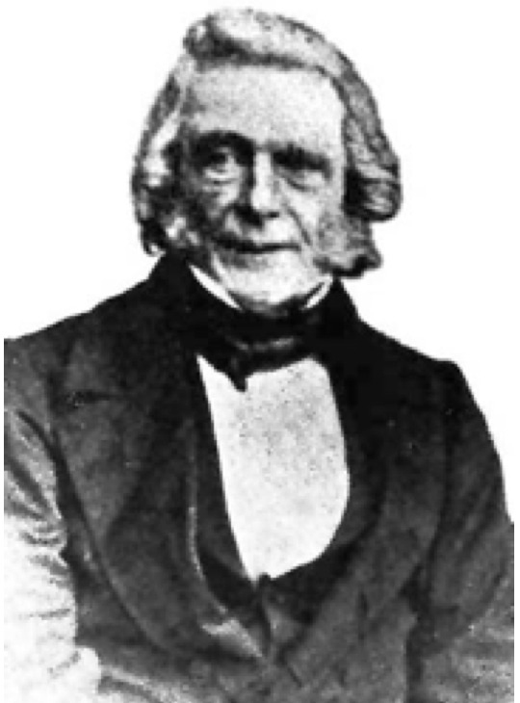
A bit of trivia
The theory of natural selection was first proposed by ...Patrick Matthew
Matthew seemed to regard the idea as more or less self-evident and not in need of further development.
In a stunning example of how not to communicate science, he published his ideas in appendices B and F of his book “On Naval Timber and Arboriculture” (1831).
Unsurprisingly, his peers failed to discover his ideas in such an obscure source, and his work had no impact on the subsequent, more developed, work of Darwin and Wallace (1859).
Do not emulate Patrick Matthew.

Slide 5
Natural Selection
Mutation, recombination and other processes introduce variation into genomes of organisms
The fitness of an organism describes how well it can survive/grow/function/replicate in a given environment, or how well it can pass on its genetic material to future generations
The same mutation can have different fitness costs in different environments (fitness landscape), and different genetic backgrounds (epistasis)
Any particular mutation can be:
Neutral: no or little change in fitness (the majority of genetic variation falls into this class according to the neutral theory)
Deleterious: reduced fitness
Adaptive: increased fitness

Slide 6
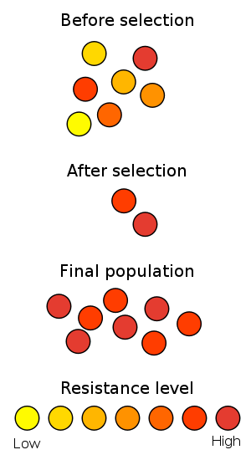
Time
http://en.wikipedia.org/wiki/File:Antibiotic_resistance.svg

Slide 7

https://www.youtube.com/watch?v=plVk4NVIUh8

Slide 8
Example: MHC-restricted CTL killing of infected cells
CD8+ Cytotoxic T-lymphocytes (CTLs) effect cell-mediated immune response
Foreign (e.g., viral) proteins are cleaved by the proteasome in infected cells, transported by the Transporter associated with antigen processing (TAP) complex and loaded onto the MHC Class 1 molecule.
MHC Class 1 presents a restricted polypeptide (epitope) on the surface of the cell.
A CD8+ cells binds to presented foreign peptides via a T cell receptor (TCR) and initiates infected cell apoptosis.
https://www.mdpi.com/1420-3049/25/22/5409

Slide 9
MHC Class 1 Molecules
Present linear foreign peptides which are most commonly 9 or 10 amino acids long
Anchor sites (2 and 9) are usually important for binding and recognition
Mutations which alter the peptide can hinder or prevent CTL response activation

Slide 10
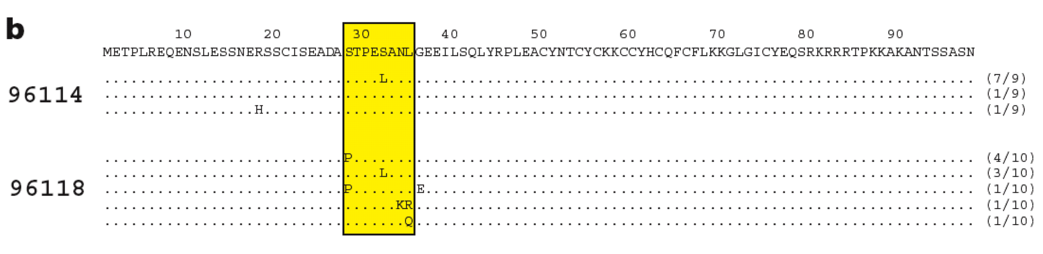
Rapid SIV sequence evolution in macaques in response to CTL-driven selection
SIV: the only animal model of HIV (rhesus macaques)
Experimental infection with MHC-matched strain of SIV
Virus sequenced from a sample 2 weeks post infection
Only variation was in an epitope recognized by the MHC
CTL escape
O’Connor et al (2002) Nat Med 8(5):493–499

Slide 11
Key drivers of adaptation in pathogens
Zoonoses and transmission to new hosts (both species and individuals)
Immune selection (CTL, innate, antibody)
Development of drug resistance
Virulence/transmissibility
Host/pathogen arms-races, e.g. host antiviral factors
Most of the time, most of the viral genome is conserved

Slide 12
Evolution of Coding Sequences
RNA
Transcription/
Assembly
Coding DNA sequence
Codon translation to amino-acids
4→4
61→20
Proper unit of evolution is a triplet of nucleotides — a codon
Mutation happens at the DNA level
Selection happens (by and large) at the protein level
Synonymous (protein sequence unchanged) and non-synonymous (protein sequence changed) substitutions are fundamentally different

Slide 13
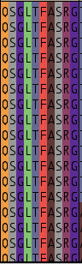
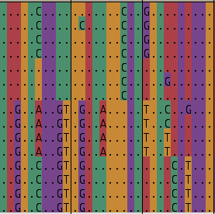
Conservation:
measles, rinderpest, and peste-de-petite ruminant viruses nucleoprotein.
Nucleotides
Amino acids

Slide 14
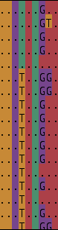

Diversification:
an antigenic site in H3N2 IAV hemagglutinin
Nucleotides
Amino acids

Slide 15
Molecular signatures of selection
Because synonymous substitutions do not alter the protein, we often posit that they are neutral
The rate of accumulation of synonymous substitutions (dS) can serve as the neutral background evolutionary rate
We can compare the rate of accumulation of non-synonymous substitutions (dN), which alter the protein sequence, to dS and use their ratio to classify the nature of the evolutionary process
What can the denominator proportions depend on?

Slide 16
Evolutionary Modes
Positive Selection (Diversifying) | dS < dN or ω := dN/dS > 1
Negative Selection | dS > dN or ω < 1
Neutral Evolution | dS ≃ dN or ω ≃ 1

Slide 17
Estimating dS and dN
Consider two aligned homologous sequences
 | Site 1 | Site 2 | Site 3 | Site 4 | Site 5 | Site 6
DNA | ACA | ATA | ATC | TTT | AAT | CAA
AA | T | I | I | F | N | Q
DNA | ACA | ATA | ACC | TTT | AAC | CAA
AA | T | I | T | F | N | Q
Can one claim that dN/dS = 1, because there is one synonymous and one non-synonymous substitution?

Slide 18
Universal genetic code
This genetic code has 61 sense (non-termination) codons
Substitution types
Synonymous Non-synonymous To a stop codon
Transitions Transversions Total | Transitions Transversions Total | Total
1st position: 8 0 8 140 26 166 9
2nd position: 0 0 0 148 28 176 7
3rd position: 58 68 126 2 48 50 7
------------------------------------------------------------------------------
Total 66 68 134 290 102 392 23
Approximately 3:1(392 N : 134 S)ratio when mutations are generated and fixed completely at random
Non-random distribution over codon positions
All second position mutations are non-synonymous
Most (but not all) synonymous mutations are confined to the third position

Slide 19
Neutral expectation
A random mutation is ~3 times more likely to be non-synonymous that synonymous, depending on the variety of factors, such as codon composition, transition/transversion ratios, etc.
We need to estimate the proportion of random mutations that are synonymous, and use it as a reference to compute dS.
In early literature, these quantities were codified as synonymous and non-synonymous “sites” and/or mutational opportunity.
As a very crude approximation (assuming that third positions ~ synonymous), each codon has 1 synonymous and 2 non-synonymous sites.

Slide 20
Computing synonymous and non-synonymous sites for GAA (Glutamic Acid)
 | 1 | 2 | 3
Start codon: | G | A | A
A | AAA Lysine | * | *
C | CAA Glutamine | GCA Alanine | GAC Aspartic Acid
G | * | GGA Glycine | GAG Glutamic Acid
T | TAA Stop | GTA Valine | GAT Aspartic Acid
Synonymous changes | 0 | 0 | 1
Non-synonymous changes | 3 | 3 | 2
Synonymous sites | 0 | 0 | 1/3
Non-synonymous sites | 1 | 1 | 2/3
8/3 non-synonymous sites (or 7/3 + 1/3 “stop” site)
1/3 synonymous sites

Slide 21
Nei-Gojobori dN/dS estimate (NG86)
For each codon C we define ES(C) and EN(C) - the numbers of synonymous and non-synonymous sites of a codon
e.g., ES(GAA) = 1/3, EN(GAA) = 8/3.
May also define them as fractions of substitutions that do not lead to stop codons,
e.g., ES(GAA) = 1/3, EN(GAA) = 7/3.
The sum of ES and EN over all codons in a sequence gives an estimate of expected synonymous and non-synonymous sites in a sequence.
For two sequences (the target of the original method), we average ES(C) and EN(C) at each site.
EN/ES is thus the expected ratio of non-synonymous to synonymous substitutions counts under neutral evolution
Simple methods for estimating the numbers of synonymous and nonsynonymous nucleotide substitutions
M. Nei and T. Gojobori
Mol. Biol. Evol. 3 418--426 (1986)
>5,300 citations

Slide 22
NG86 example
 | Site 1 | Site 2 | Site 3 | Site 4 | Site 5 | Site 6
Seq1 | ACA | ATA | ATC | TTT | AAT | CAA
Syn | 1 | 2/3 | 2/3 | 1/3 | 1/3 | 1/3
NonSyn | 2 | 7/3 | 7/3 | 8/3 | 8/3 | 7/3
Seq2 | ACA | ATA | ACC | TTT | AAC | CAA
Syn | 1 | 2/3 | 1 | 1/3 | 1/3 | 1/3
NonSyn | 2 | 7/3 | 2 | 8/3 | 8/3 | 7/3
Syn | 1 | 2/3 | 5/6 | 1/3 | 1/3 | 1/3
NonSyn | 2 | 7/3 | 13/6 | 8/3 | 8/3 | 7/3
Mean
ES = 3½, EN = 14⅙: under neutrality, we expect the ratio of non-synonymous to synonymous substitutions of EN/ES ~ 4.05

Slide 23
NG86 example
The observed N/S ratio (1.0) is lower than the expected EN/ES ratio (4.05).
The ratio of the ratios (N:S)/(EN:ES) yields dN/dS = 1/4.05 ~ 0.25.
This ratio quantifies the excess or paucity of non-synonymous substitutions and is near dN/dS = 1 for neutrally evolving sequences/sites.
Because there are fewer non-synonymous substitutions than expected under neutrality, we conclude that most non-synonymous mutations are removed by natural selection, i.e., the sequences are under negative selection
If there were more non-synonymous substitutions than expected, we would conclude that many non-synonymous mutations are fixed due to natural selection, i.e., the sequences are under positive selection

Slide 24
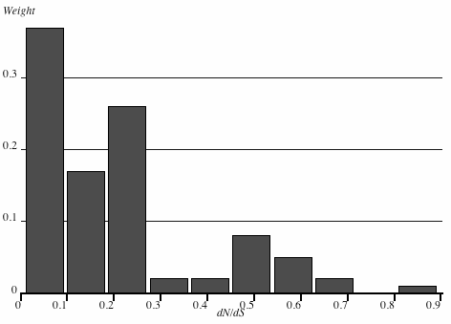
NG86 example
How reliable is the inference based on only 6 codons?
Obtain sampling variance via bootstrap (or by limiting approximations)
In this case, dN/dS is significantly less than 1.0 (p ~ 0.01)
Bootstrapped distribution of dN/dS
Count = 100
Mean = 0.207385
Median = 0.166687
Variance = 0.0490168
Std.Dev = 0.221397
COV = 1.06757
Sum = 20.7385
Sq. sum = 9.15351
Skewness = 0.266313
Kurtosis = 33.381
Min = 0
2.5% = 0
97.5% = 0.741176
Max = 1
Observed
Neutral

Slide 25
NG86 limitations: multiple substitutions
How many synonymous and how many non-synonymous substitutions does it take to replace CCA with CAG?
Assume the shortest path (minimum of 2 substitutions)
CCA (Proline)⟹ CAA (Histidine) ⟹ CAG (Glutamine)
CCA (Proline)⟹ CCG (Proline) ⟹ CAG (Glutamine)
Average over the two possible paths: 0.5 synonymous and 1.5 non-synonymous substitutions.
Intuitively, paths should not be equiprobable, e.g., because it should be more expensive to route evolution through (presumably) suboptimal intermediate amino-acids.

Slide 26
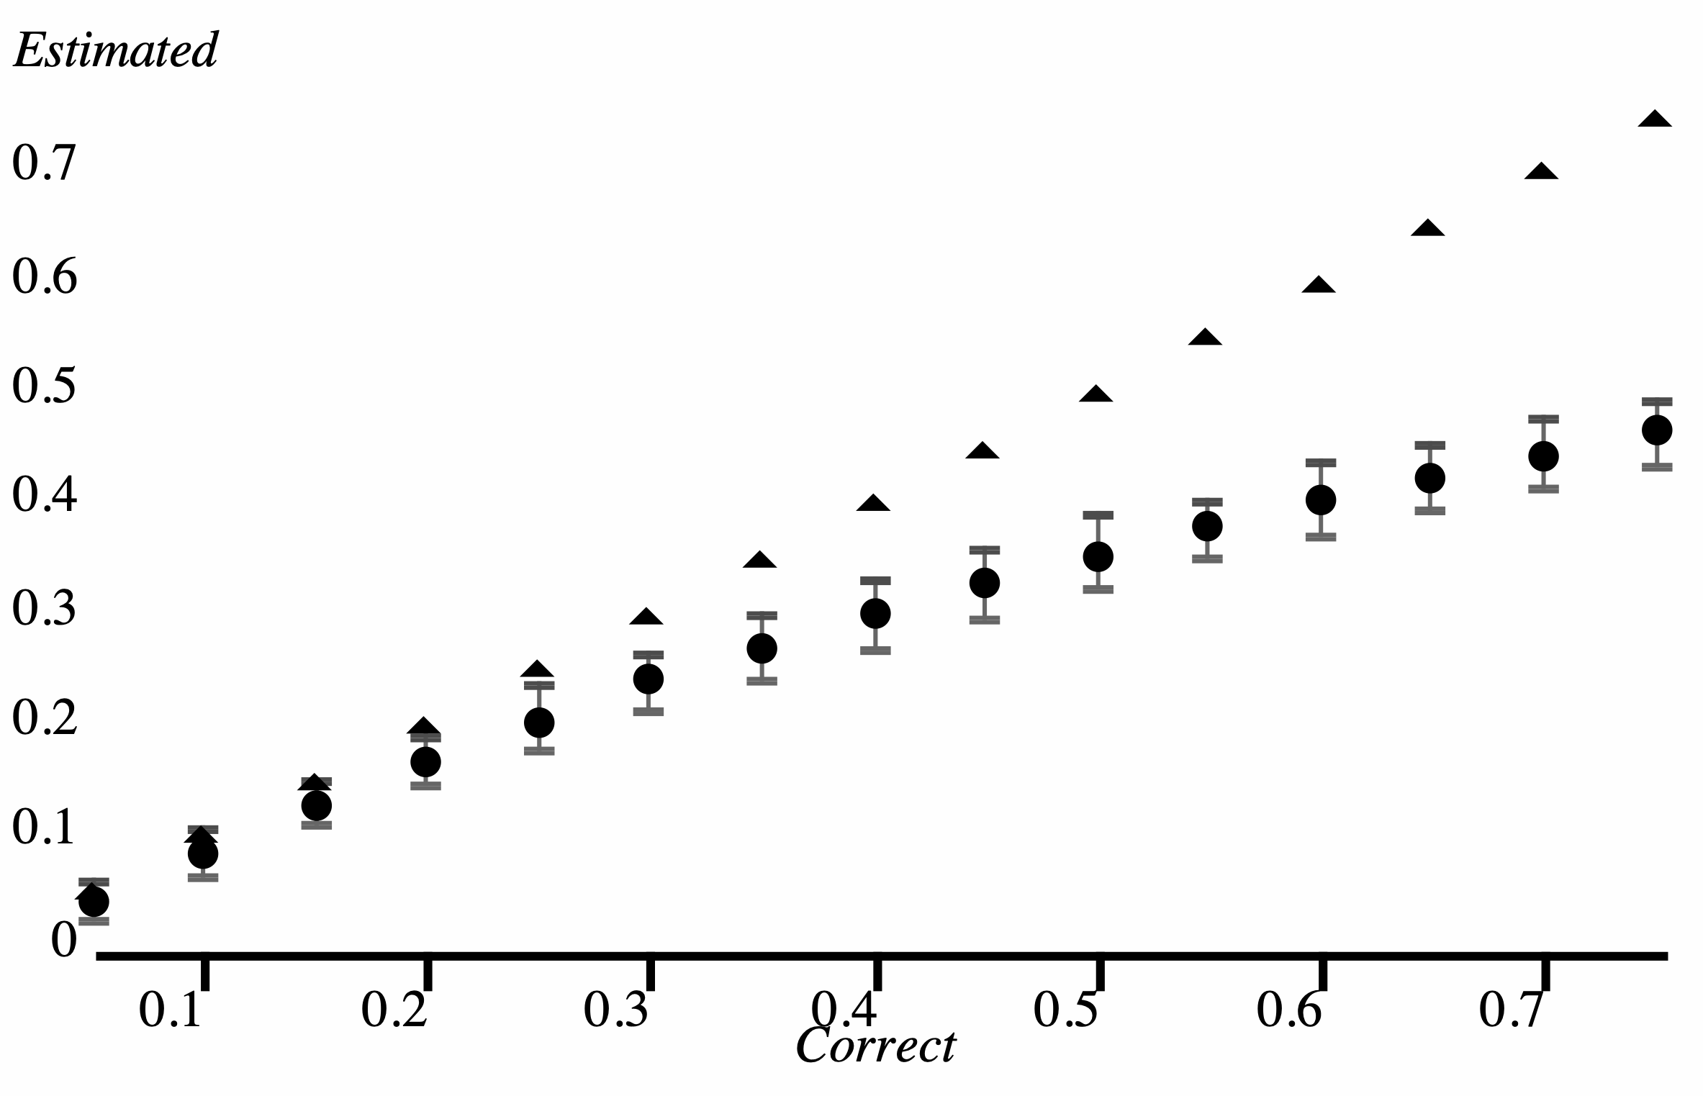
NG86 limitations: underestimation of substitution counts for higher divergence levels
Simulated divergence vs that estimated by p-distance
Simulated 100 replicates of 1000 nucleotide long sequences for various divergence levels (substitutions/site)
Even for divergence of 0.25 (1/4 sites have mutation on average), p-distance already significantly underestimates the true level: 0.2125 (0.19-0.241 95% range)
Underestimation becomes progressively worse for larger divergence levels

Slide 27
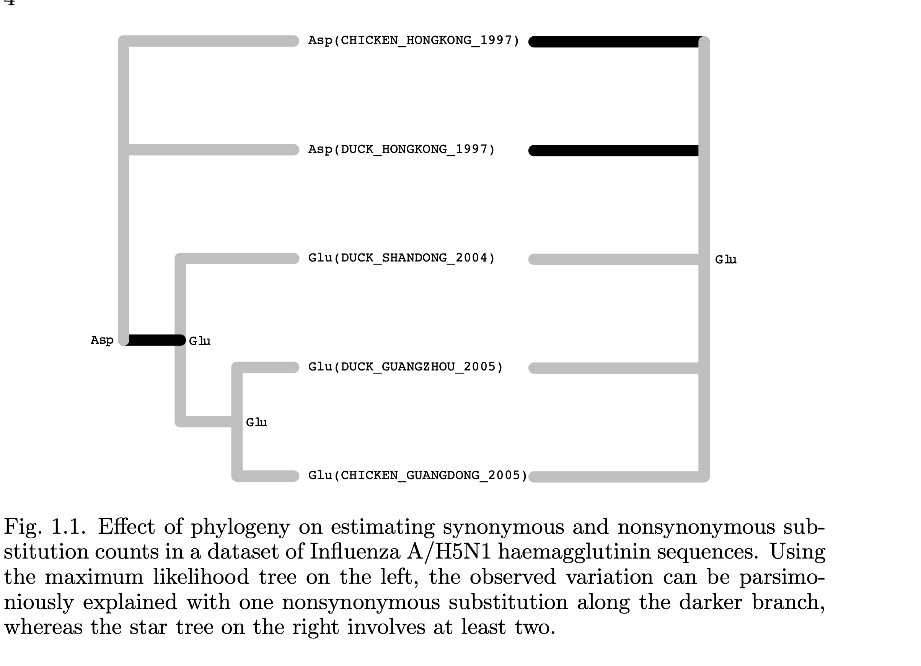
NG86 limitations: ignoring phylogenies
http://www.hyphy.org/resources/hyphybook2007.pdf

Slide 28
NG86 limitations: averaging across all sites in a gene
Different sites in a gene will be subject to different selective forces.
A gene-wide measure of selection is going to average these effects.
Most sites in most genes will be maintained by purifying selection.
Positively selected sites are of great biological interest, because they point to how a particular gene can respond to selective pressures.
Negatively selected sites are also of interest, because they point to functional constraint, and could be used to guide drug or vaccine design.
Must develop methods that are able to disentangle the contributions of individual sites.

Slide 29
Suzuki-Gojobori (SG99): the penultimate extension of NG86
Uses a tree to compute dN/dS at a given site
Reconstruct ancestral sequences by nucleotide-level parsimony
Compute EN and ES using labeled branches; define pe = ES/EN
Compute S and NS for each site (minimum evolution)
Estimate the probability that the number of synonymous substitutions S is unusually low (positive selection) or unusually high (negative selection), using the binomial distribution given pe from step 2.
A method for detecting positive selection at single amino acid sites
Y. Suzuki and T. Gojobori
Mol Biol Evol 16 1315-1328 (1999)
>500 citations

Slide 30
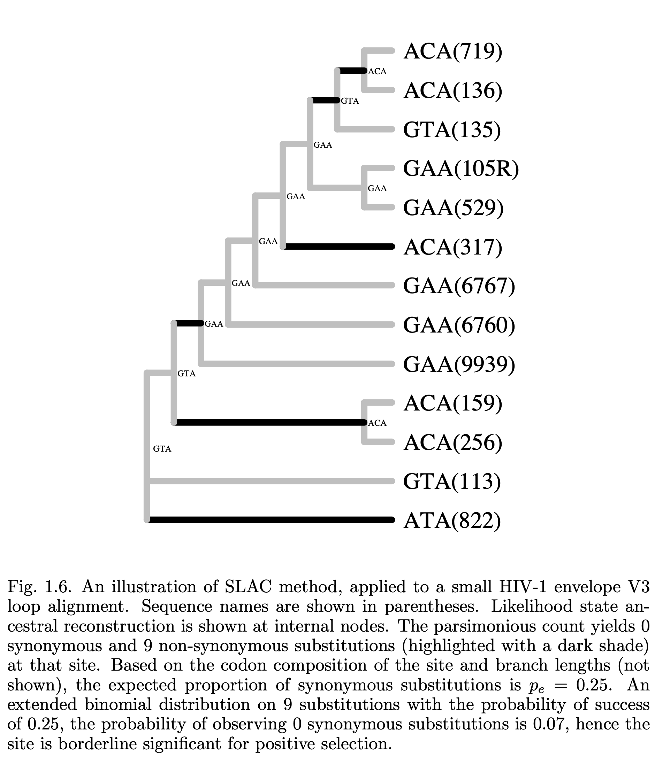

Slide 31
Any questions on the previous material?
We have covered:
Brief background and examples of natural selection
dN/dS as a tool to measure the action of natural selection, explained using the first counting method for estimating dN/dS (Nei-Gojobori, 1986) and its extensions
Next section: Codon substitution models — the basis of modern (1998-) dN/dS estimation approaches

Slide 32
Codon-substitution models
In 1994, first tractable mechanistic evolutionary models for codon sequences were proposed by Muse and Gaut (MG94), and, independently, by Goldman and Yang (GY94) [in the same issue of MBE, back to back]
Markov models of codon substitution provide a powerful framework for estimating substitution rates from coding sequence data, as they
encode our mechanistic understanding of the evolutionary process,
enable one to compute the phylogenetic likelihood,
permit hypothesis testing or Bayesian inference,
systematically account for confounding processes (unequal base frequencies, nucleotide substitution biases, etc.),
afford many opportunities for extension and refinement (still happening today).
A likelihood approach for comparing synonymous and nonsynonymous nucleotide substitution rates, with application to the chloroplast genome
S. V. Muse and B. S. Gaut
Mol Biol Evol 11 715-724 (1994)
A codon-based model of nucleotide substitution for protein-coding DNA sequences.
N. Goldman and Z. Yang
Mol Biol Evol 11 725--736 (1994)
~1000 citations
~2250 citations

Slide 33
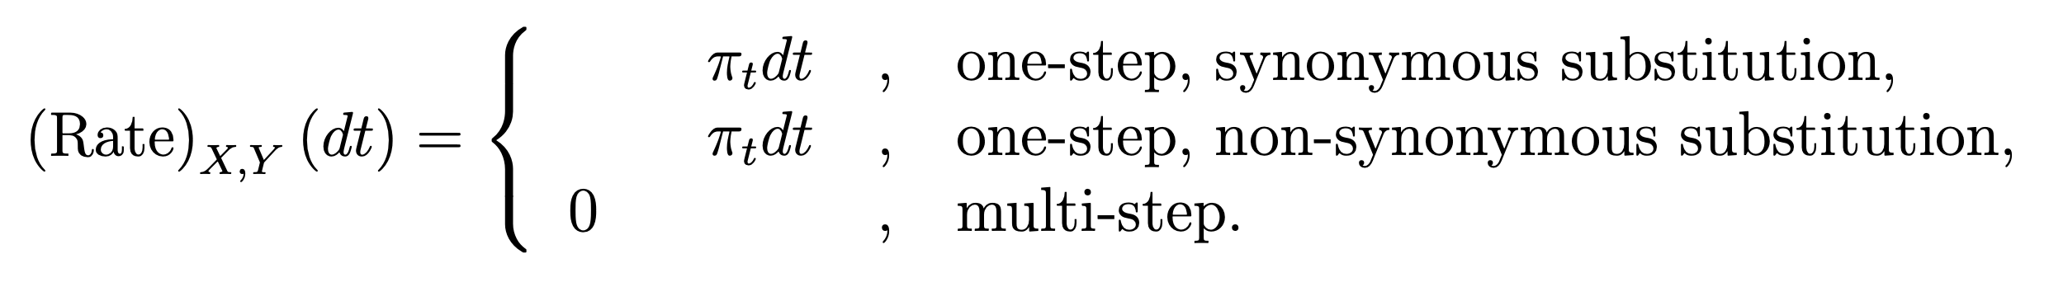
Rate matrix for an MG-style codon model
α
β
X,Y = AAA...TTT (excluding stop codons),
πt - frequency of the target nucleotide.
Example substitutions:
AAC→AAT (one step, synonymous - Asparagine)
CAC→GAC (one step, non-synonymous - Histidine to Aspartic Acid)
AAC→GTC (multi-step).
αR_{CT}
βR_{CG}
α (syn. rate) and β (non-syn. rate) are the key quantities for all selection analyses

Slide 34
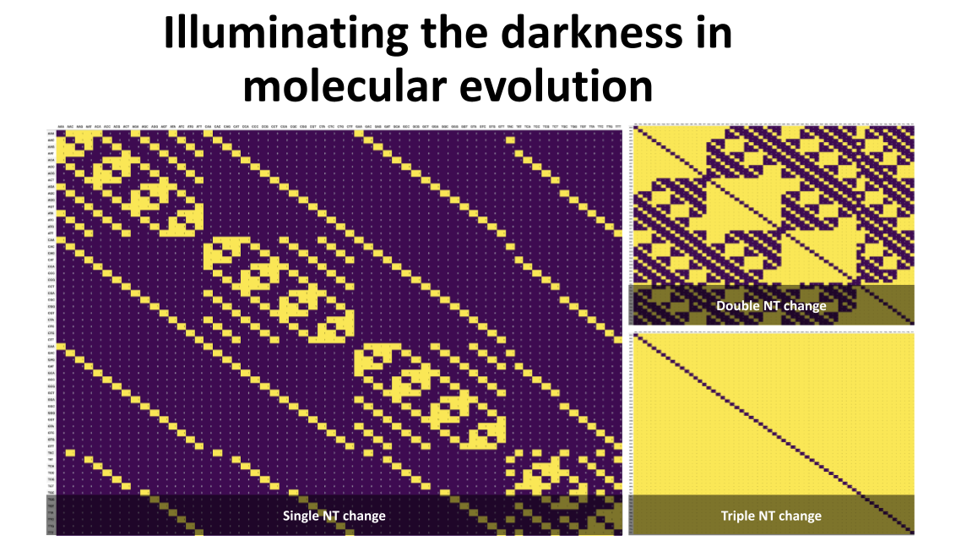

Slide 35
Computing the transition probabilities
In order to recover transition probabilities T(t) from the rate matrix Q, one computes the matrix exponential T(t) = exp (Qt), same as with standard nucleotide models, e.g. HKY85 or GTR.
Because the computational complexity of matrix exponentiation scales as the cube of the matrix dimension, codon based models require roughly (61/4)³ ≈ 3500 more operations than nucleotide models.
This explains why codon probabilistic models were not introduced until the 1990s, even though they are relatively straightforward extensions of 4x4 nucleotide models

Slide 36
Multiple substitutions
The model assumes that point mutations alter one nucleotide at a time, hence most of the instantaneous rates:
(3134/3761 or 84.2% in the case of the universal genetic code) are 0.
This restriction, however, does not mean that the model disallows any substitutions that involve multiple nucleotides (e.g., ACT⟹AGG).
This can be further relaxed with models supporting multiple nucleotide changes.
Such substitutions must simply be realized via several single nucleotide steps, e.g., ACT⟹AGT⟹AGG
In fact the (i,j) element of T(t) = exp(Qt) sums the probabilities of all such possible pathways of duration t, including reversions
Compare this to the naive NG86 parsimony approach.

Slide 37
Alignment-wide estimates
Using standard MLE approaches it is straightforward to obtain point estimates of dN/dS := β/α
Can also easily test whether or not dN/dS > 1, or < 1 using the likelihood ratio test (LRT)
Codon models also support the concepts of synonymous and non-synonymous distances between sequences using standard properties of Markov processes (exponentially distributed waiting times)

Slide 38
Three example datasets
West Nile Virus NS3 protein
An interesting case study of how positive selection detection methods lead to testable hypotheses for function discovery
Brault et al 2007, A single positively selected West Nile viral mutation confers increased virogenesis in American crows
HIV-1 transmission pair
Partial env sequences from two epidemiologically linked individuals
An example of multiple selective environments (source, recipient, transmission)
SARS-CoV-2 Spike
Full length spike sequences chosen to represent viral diversity (circa mid 2021)
Good example for analyzing selection in population samples with many “dead-end” intra-host variants

Slide 39
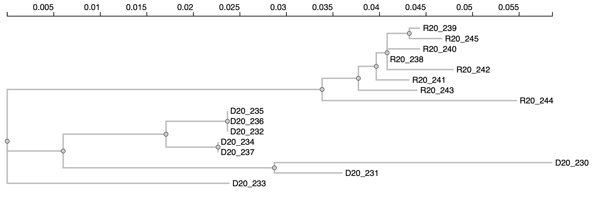
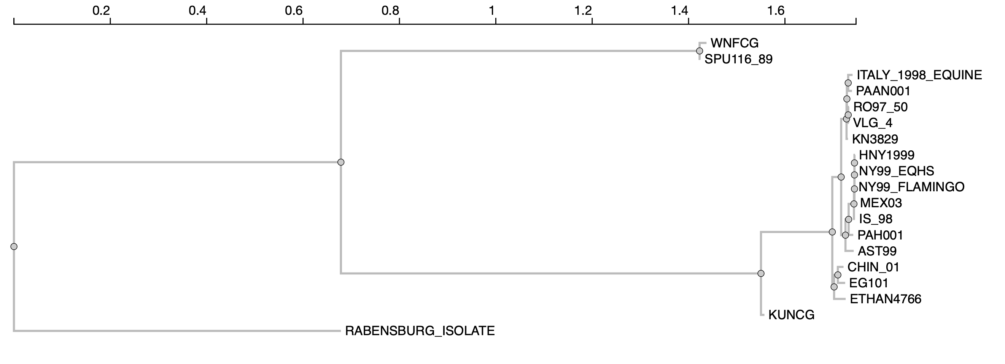
Transmission branch
Recipient
HIV-1 env
Source
WN NS3
http://phylotree.hyphy.org

Slide 40
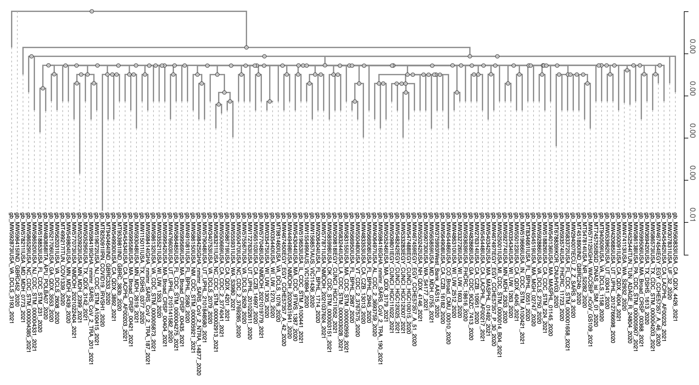
SARS-CoV-2 spike
http://phylotree.hyphy.org

Slide 41
Information content of the alignments
 | WNV NS3 | HIV-1 env | SARS-CoV-2 spike
Sequences | 19 | 16 | 118
Codons | 619 | 288 | 1273
Tree Length MG94 model, subs/site | 0.67 | 0.20 | 0.134
How do you expect these measures to correlate with the ability to detect selection?

Slide 42




MSA
Tree
Settings
HyPhy analysis
MarkDown screen output
JSON file with analysis results
vision.hyphy.org

Slide 43
$hyphy ~/hyphy-analyses/FitMG94/FitMG94.bf --help
Available analysis command line options
---------------------------------------
Use --option VALUE syntax to invoke
If a [required] option is not provided on the command line, the analysis will prompt for its value
[conditionally required] options may or not be required based on the values of other options
rooted
Accept rooted trees
default value: No
code
Which genetic code should be used
default value: Universal
alignment [required]
An in-frame codon alignment in one of the formats supported by HyPhy
tree [conditionally required]
A phylogenetic tree
applies to: Please select a tree file for the data:
type
Model type: global (single dN/dS for all branches) or local (separate dN/dS)
default value: terms.global [computed at run time]
applies to: Model Type
frequencies
Equilibrium frequency estimator
default value: CF3x4
lrt
Perform LRT to test which for dN/dS == 1 (global model only)
default value: No
output
Write the resulting JSON to this file (default is to save to the same path as the alignment file + 'MG94.json')
default value: fitter.codon_data_info[terms.json.json] [computed at run time]
save-fit
Save MG94 model fit to this file (default is not to save)
default value: /dev/null
https://github.com/veg/hyphy-analyses/

Slide 44
$hyphy ~/hyphy-analyses/FitMG94/FitMG94.bf --lrt Yes --alignment data/WestNileVirus_NS3.fas
Analysis Description
--------------------
Fit an MG94xREV model with several selectable options frequency
estimator and report the fit results including dN/dS ratios, and
synonymous and non-synonymous branch lengths. v0.2 adds LRT test for
dN/dS != 1
- __Requirements__: in-frame codon alignment and a phylogenetic tree
- __Written by__: Sergei L Kosakovsky Pond
- __Contact Information__: spond@temple.edu
- __Analysis Version__: 0.2
rooted: No
>code –> Universal
>Loaded a multiple sequence alignment with **19** sequences, **619** codons, and **1** partitions from `/Users/sergei/Dropbox/Talks/VEME-2021/data/WestNileVirus_NS3.fas`
>type –> global
>frequencies –> CF3x4
>lrt –> Yes
### Obtaining branch lengths and nucleotide substitution biases under the nucleotide GTR model
>kill-zero-lengths –> Yes
https://github.com/veg/hyphy-analyses/

Slide 45
### Deleted 2 zero-length internal branches: `Node1, Node2`
* Log(L) = -7745.48, AIC-c = 15577.06 (43 estimated parameters)
* 1 partition. Total tree length by partition (subs/site) 0.672
### Fitting Standard MG94
* Log(L) = -6413.46, AIC-c = 12923.31 (48 estimated parameters)
* non-synonymous/synonymous rate ratio = 0.0086 (95% profile CI 0.0068- 0.0106)
### Running the likelihood ratio tests for dN/dS=1
>Testing _non-synonymous/synonymous rate ratio_ == 1
Likelihood ratio test for _non-synonymous/synonymous rate ratio == 1_, **p = 0.0000**.
### **Synonymous tree**
(HNY1999:0.001081256453028512,NY99_EQHS:0.00106649816840513,NY99_FLAMINGO:0,(((((((RABENSBURG_ISOLATE:1.029888927913287,(WNFCG:0.009422232735390165,SPU116_89:0.006497252142983255)Node11:0.497317793054674)Node9:0.5663849238543818,KUNCG:0.08579616334765416)Node8:0.06828112532356265,(ETHAN4766:0.02340594686858863,(CHIN_01:0.0118388155978261,EG101:0.01478394721830331)Node17:0.007544440407300843)Node15:0.003379513965204242)Node7:0.01817281158535988,(((ITALY_1998_EQUINE:0.00887303413005913,PAAN001:0.007729652361011649)Node22:0.002644276626382983,(RO97_50:0.001612279279163659,VLG_4:0.001062750677413841)Node25:0.002742110200748272)Node21:0.0007107517172592428,KN3829:0.003002207398871611)Node20:0.01077767481707601)Node6:0.009122506962674462,AST99:0.01648683046482152)Node5:0.006360440965550713,PAH001:0.009764197227613279)Node4:0.01061342075646687,IS_98:0.00219787558408969)Node3:0.001024759833708216,MEX03:0.003214366196457822)
### **Non-synonymous tree**
(HNY1999:2.022605013917642e-05,NY99_EQHS:1.994998075348657e-05,NY99_FLAMINGO:0,(((((((RABENSBURG_ISOLATE:0.01926516603476631,(WNFCG:0.0001762528687761419,SPU116_89:0.0001215380007608477)Node11:0.009302857420415459)Node9:0.01059483144434955,KUNCG:0.001604908342288399)Node8:0.001277270956844269,(ETHAN4766:0.0004378330909313789,(CHIN_01:0.0002214576173852258,EG101:0.0002765494317789341)Node17:0.0001411267692532066)Node15:6.321739742205773e-05)Node7:0.0003399417383968234,(((ITALY_1998_EQUINE:0.0001659795256699084,PAAN001:0.0001445913555237784)Node22:4.946400225152157e-05,(RO97_50:3.015939599470718e-05,VLG_4:1.987987995503712e-05)Node25:5.129408314941099e-05)Node21:1.329536561795865e-05,KN3829:5.615947743729441e-05)Node20:0.0002016078522568319)Node6:0.0001706461799189597,AST99:0.0003084036711952811)Node5:0.0001189788024073028,PAH001:0.0001826496777349691)Node4:0.0001985353056318952,IS_98:4.111359672255053e-05)Node3:1.916922088107983e-05,MEX03:6.012813303738528e-05)
**Combined tree**
(HNY1999:0.001101482503167688,NY99_EQHS:0.001086448149158617,NY99_FLAMINGO:0,(((((((RABENSBURG_ISOLATE:1.049154093948055,(WNFCG:0.009598485604166309,SPU116_89:0.006618790143744096)Node11:0.5066206504750898)Node9:0.5769797552987309,KUNCG:0.08740107168994253)Node8:0.06955839628040685,(ETHAN4766:0.02384377995952001,(CHIN_01:0.01206027321521132,EG101:0.01506049665008225)Node17:0.007685567176554043)Node15:0.003442731362626298)Node7:0.01851275332375671,(((ITALY_1998_EQUINE:0.009039013655729039,PAAN001:0.007874243716535429)Node22:0.002693740628634505,(RO97_50:0.001642438675158366,VLG_4:0.001082630557368879)Node25:0.002793404283897683)Node21:0.0007240470828772018,KN3829:0.003058366876308903)Node20:0.01097928266933284)Node6:0.00929315314259342,AST99:0.01679523413601681)Node5:0.006479419767958014,PAH001:0.009946846905348252)Node4:0.01081195606209877,IS_98:0.002238989180812242)Node3:0.001043929054589295,MEX03:0.003274494329495206)
### Writing detailed analysis report to `/Users/sergei/Dropbox/Talks/VEME-current/data/WestNileVirus_NS3.fas.FITTER.json'
https://github.com/veg/hyphy-analyses/

Slide 46
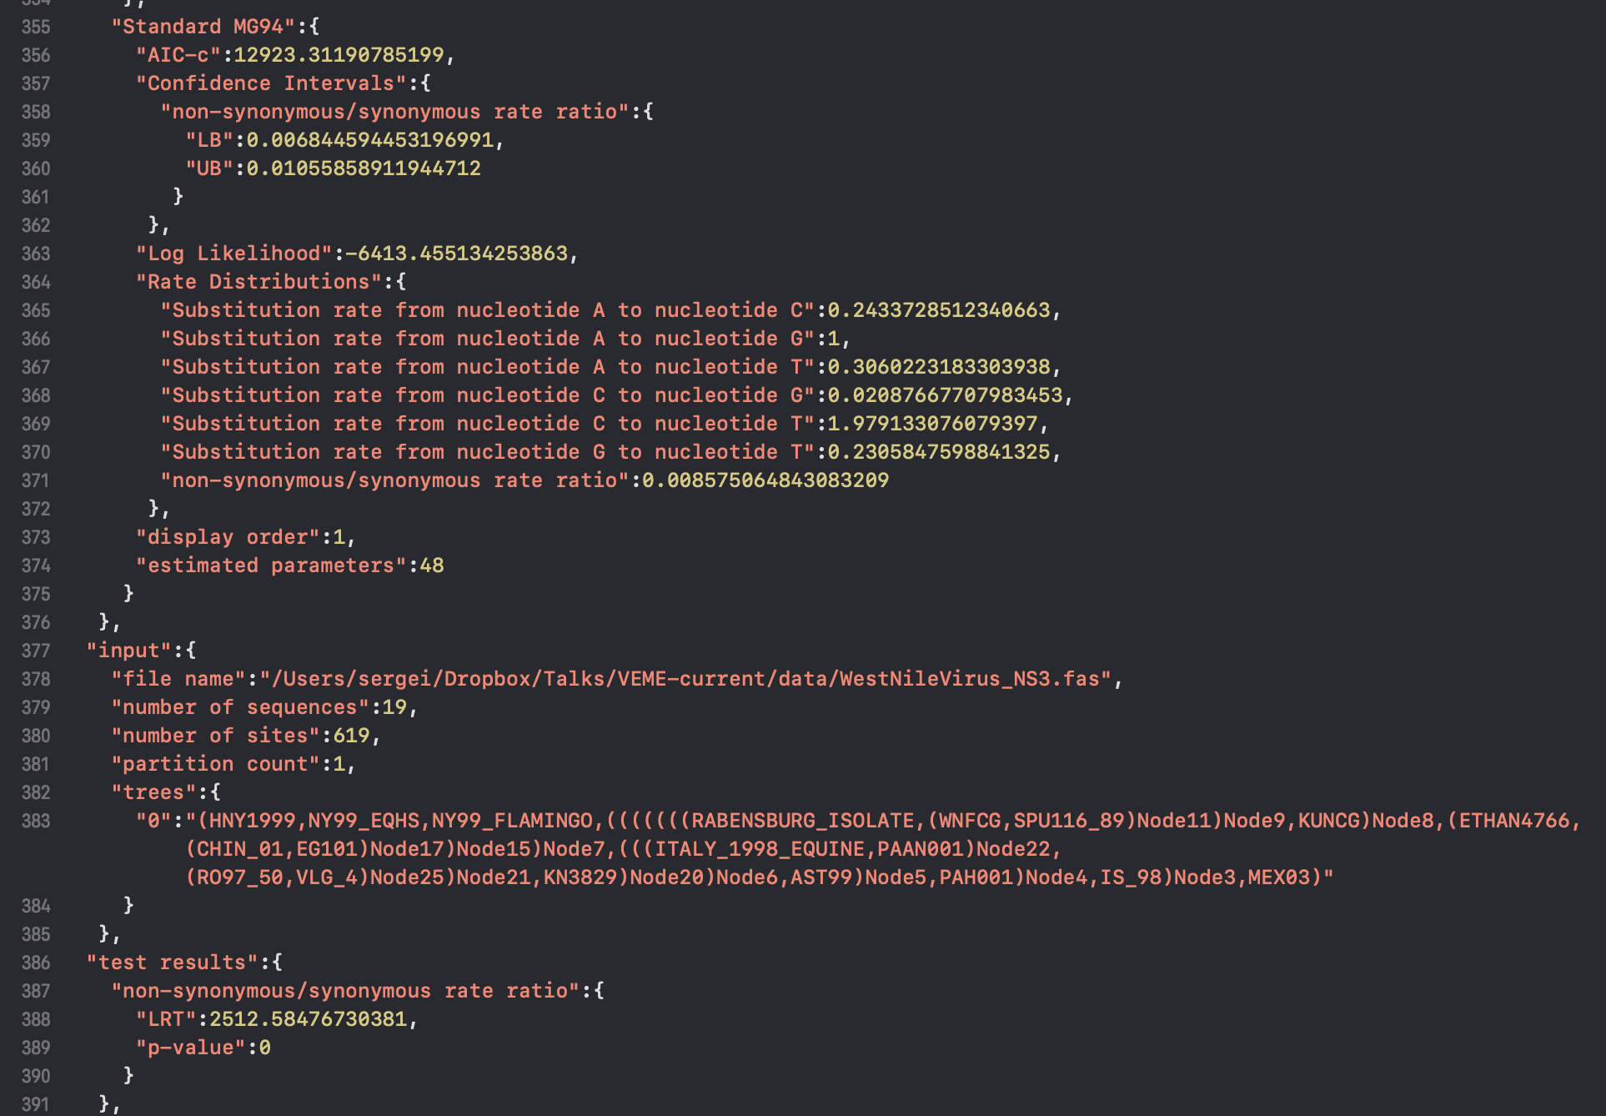
results/WestNileVirus_NS3.fna.FITTER.json
https://github.com/veg/hyphy-analyses/

Slide 47
WNV NS3
Model | Log L | # p | dN/dS | LRT | p-value
Null | -7745.48 | 49 | 1
Alternative | -6413.5 | 50 | 0.009 [0.007-0.011] | 2512.6 | ~0
Very strongly conserved
HIV-1 env
Model | Log L | # p | dN/dS | LRT | p-value
Null | -2078.3 | 40 | 1
Alternative | -2078.2 | 41 | 1.122 [0.94-1.33] | 0.33 | ~0.6
Not significantly different from neutral
SARS-CoV-2 spike
Model | Log L | # p | dN/dS | LRT | p-value
Null | -9311.0 | 176 | 1
Alternative | -9292.0 | 177 | 0.54 [0.48-0.61] | 37.94 | ~0
Very strongly conserved

Slide 48
Mean gene-wide dN/dS estimates
Are not the way to go, except when you have very small (2-3 sequence) datasets
For example:
The humoral arm of the immune system mounts a potent defense against viral infections
Existing successful vaccines are based on raising a neutralizing antibody (nAb) response to the pathogen
No simple host genetic basis (epitopes) of the specificity of neutralizing antibody responses is known
Need to measure these responses

Slide 49
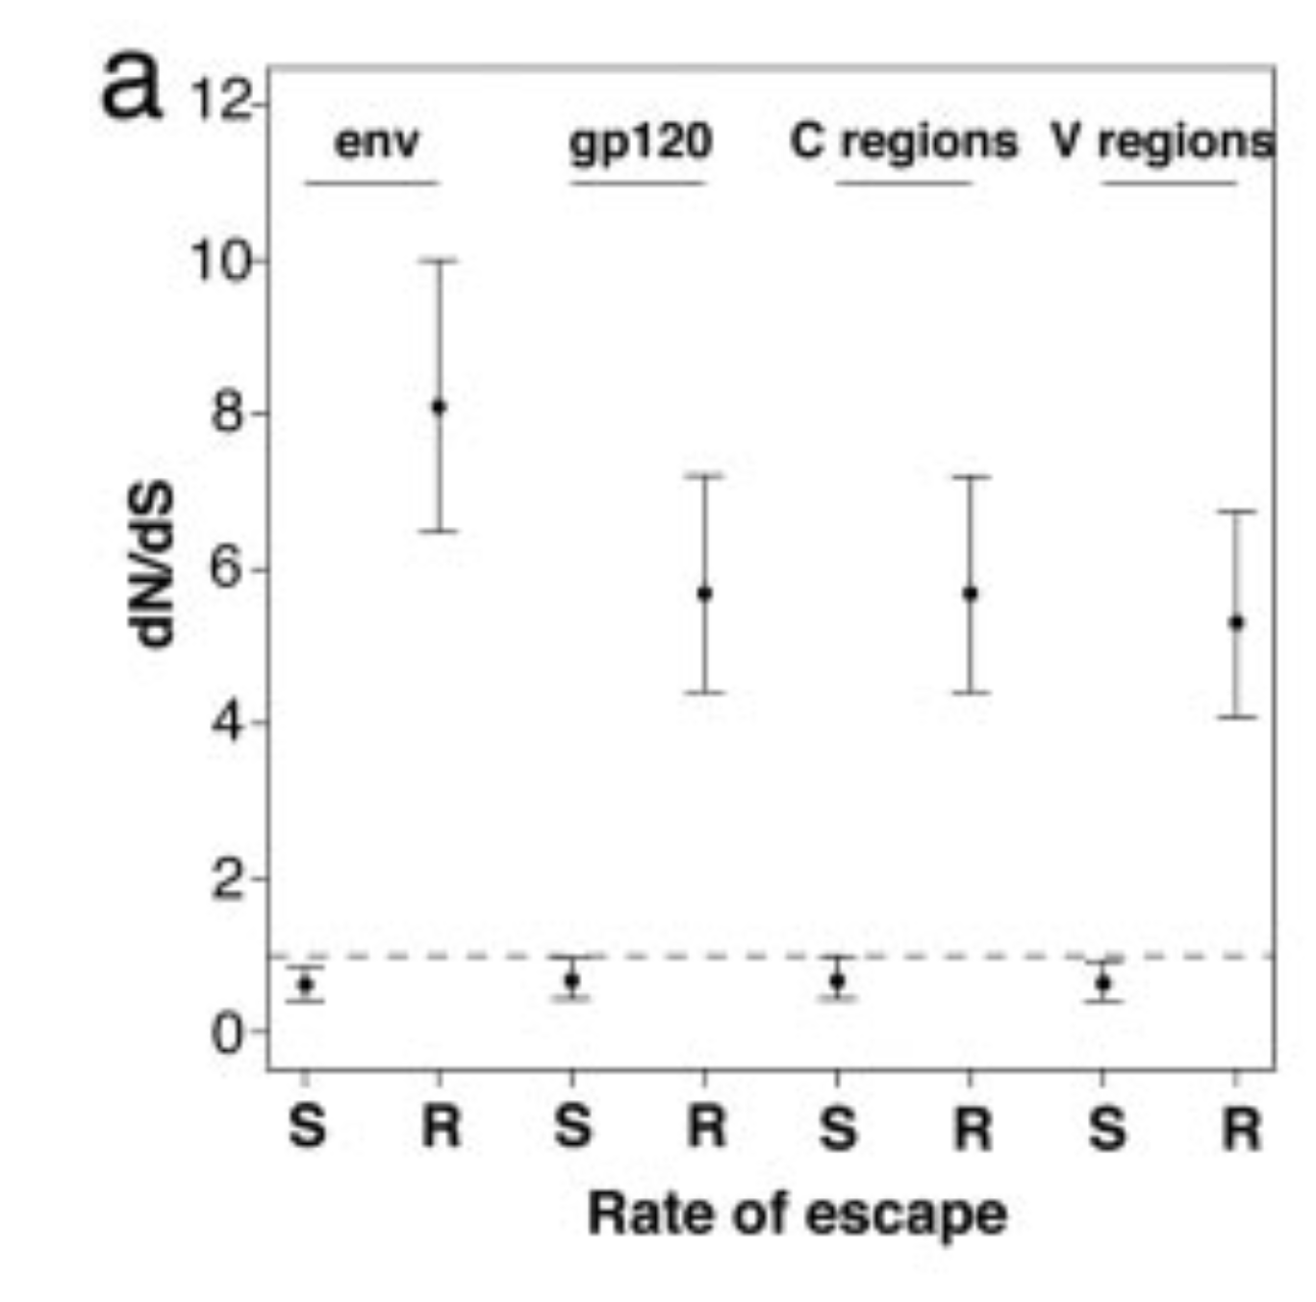
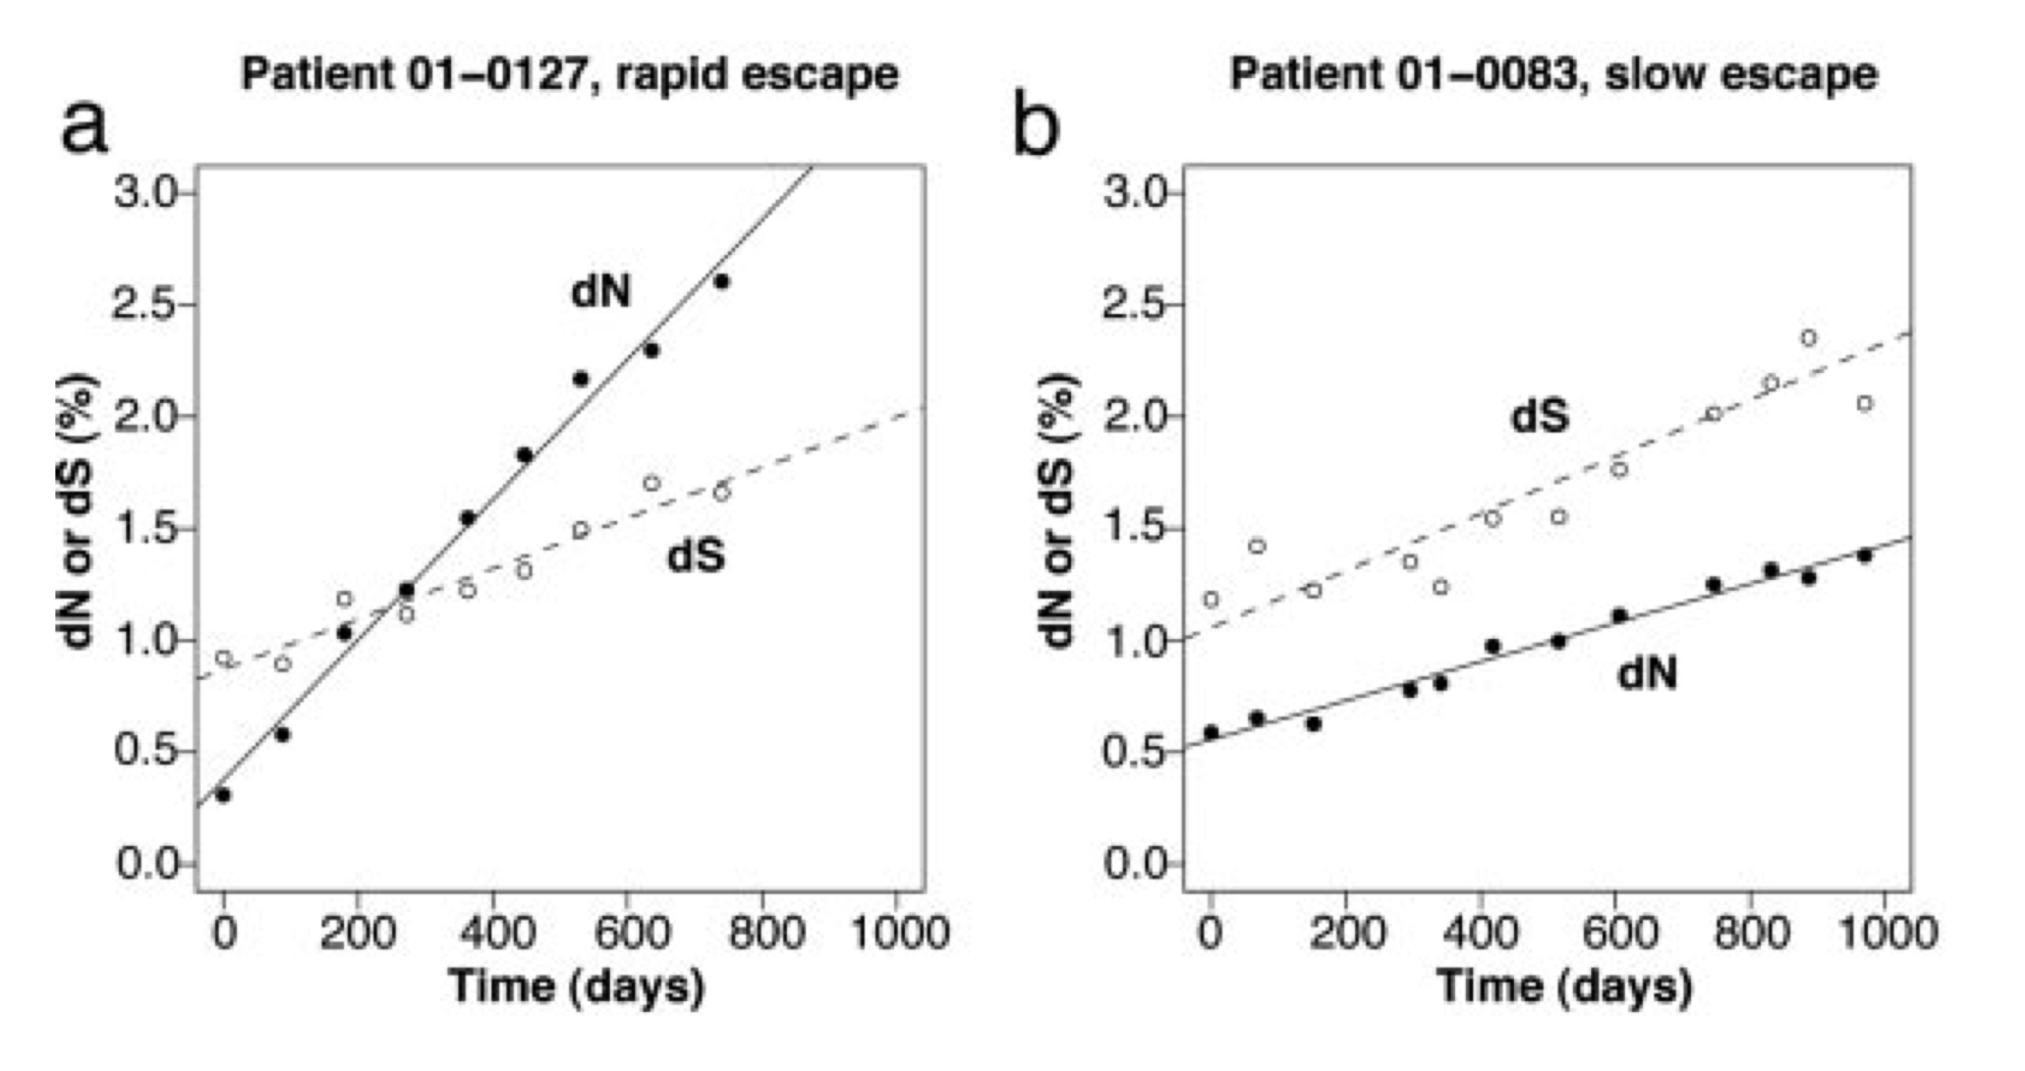
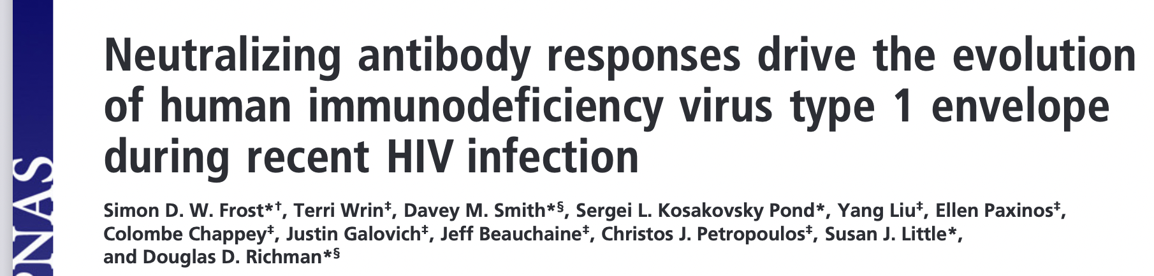
An example of mean dN/dS utility
The extent of immune selection pressure drives intra-host evolution in HIV-1
Slow (S) and Rapid (R)

Slide 50
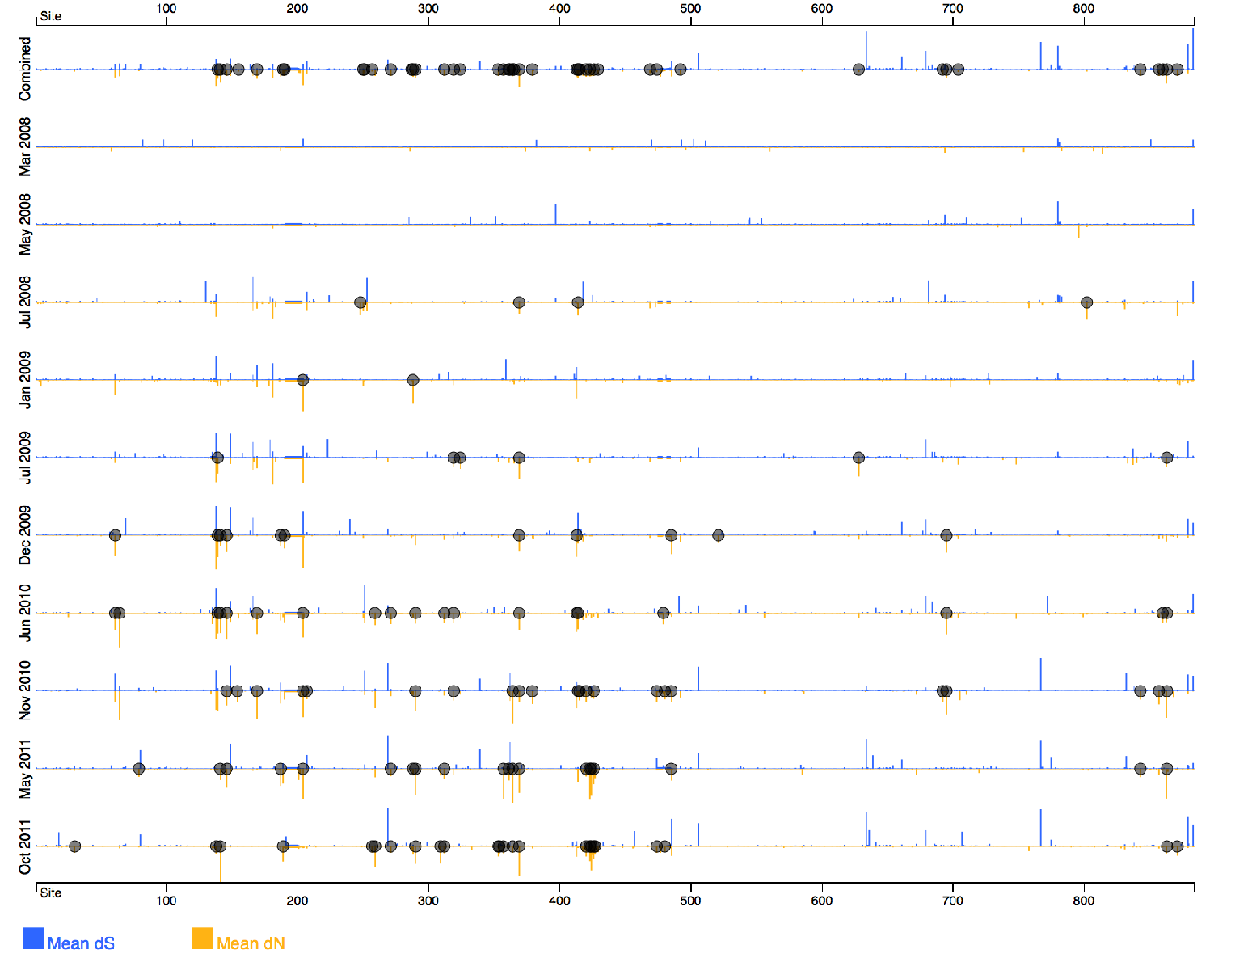
But upon closer look, this pattern is highly variable both across a gene and through time.
PLoS Pathog 12(1): e1005369. Patient 064

Slide 51
Break

Slide 52
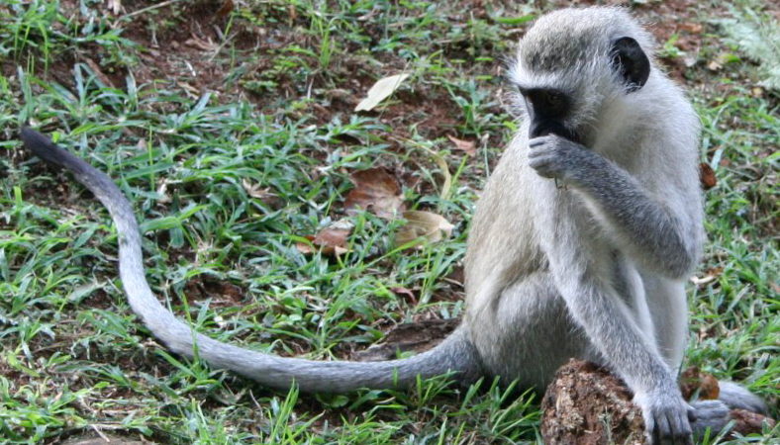



Selection inference as image processing
Branches
 | Pixel
 | Evolutionary process along a single branch at a single site
Sites

Slide 53
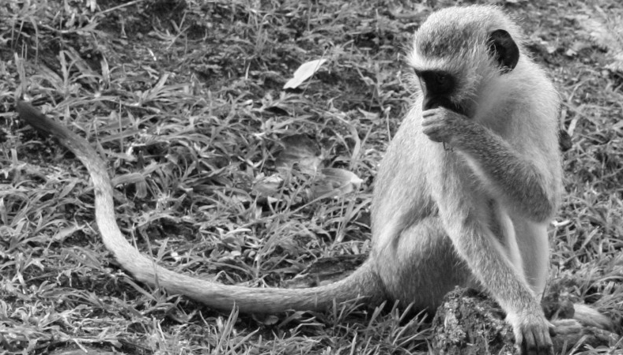
Forget about the color
Branches
Sites
 | Intensity/brightness | Color
 | Evolutionary rate (dN/dS) | Type of evolutionary/function/property change

Slide 54

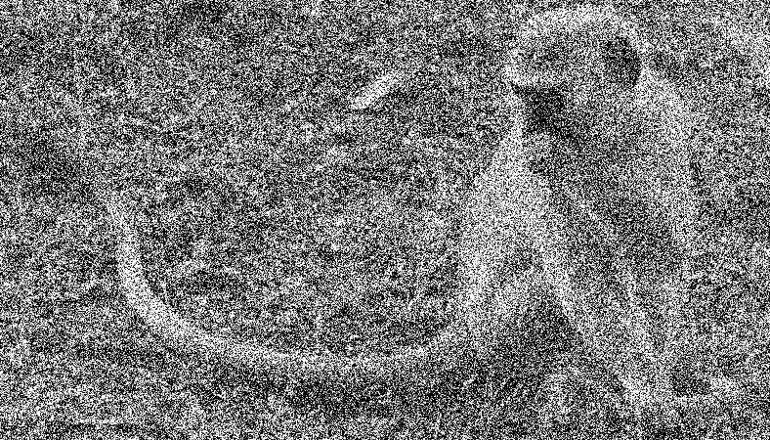
Evolution is largely unobserved and noisy
Branches
Sites
 | Visual noise
 | Saturation, missing data, model misspecification, sampling variation

Slide 55

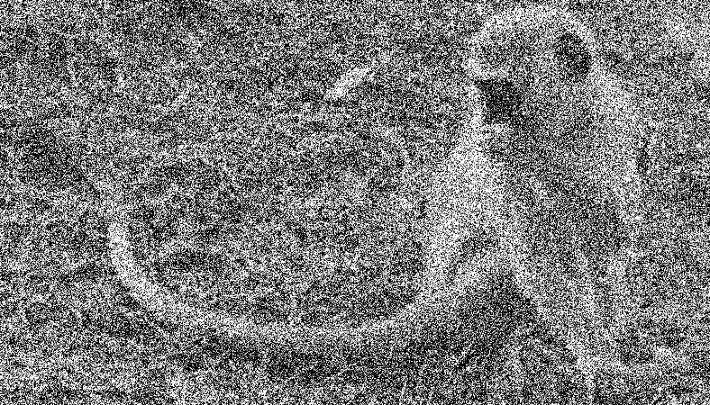
Evolution is largely unobserved and noisy (another replicate)
Branches
Sites
 | Visual noise
 | Saturation, missing data, model misspecification, sampling variation

Slide 56

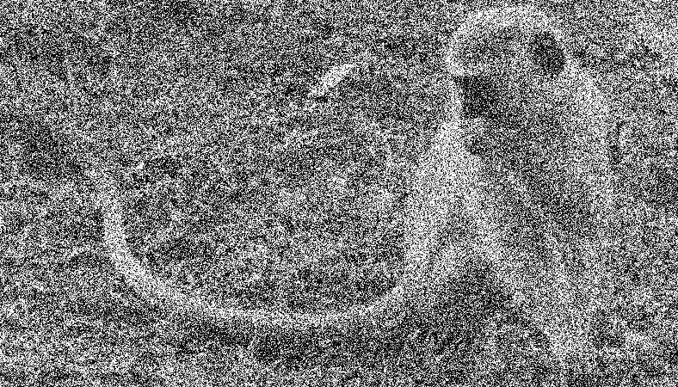
Evolution is largely unobserved and noisy (another replicate)
Branches
Sites
 | Visual noise
 | Saturation, missing data, model misspecification, sampling variation

Slide 57


High local variability
Stable global (monkey) and local (head, tail) patterns, easily discernible
Desired resolution (branch-site) is not attainable
Global (and some local) patterns should be inferable and testable
Statistical inference draws power from sample (and effect) size, need to aggregate data to gain power

Slide 58

Gene-wide selection (mean dN/dS)
Branches
Sites
 | Is the average color sufficiently “bright”
 | Is there evidence that gene-wide dN/dS > 1? Aggregate data over the entire alignment, by inferring a single dN/dS parameter from all sites and branches

Slide 59
Simple
single rate parameter
relatively compute-light
Very robust to local variation
Sample size ~ sites x branches
Very low power
most genes are on average conserved
No resolution
if selection occurred, how much of the gene was involved, and when did it happen
Rate variation model is definitely misspecified

Slide 60

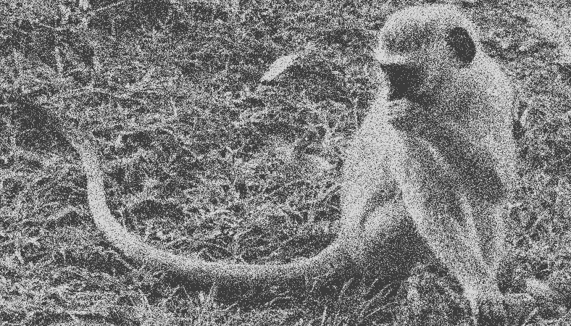
Gene-wide selection
random effects over sites and branches [BUSTED]
Branches
Sites
 | Is there enough image area that is sufficiently bright; allow each pixel to be one of K (=3) colors, chosen adaptively, e.g. to minimize perceptual differences
 | [BUSTED]: each branch-site combination is a drawn from a K-bin (dS,dN) distribution. The distribution is estimated from the entire alignment. Tests if dN/dS>1 for some branch/site pairs in the alignment

Slide 61
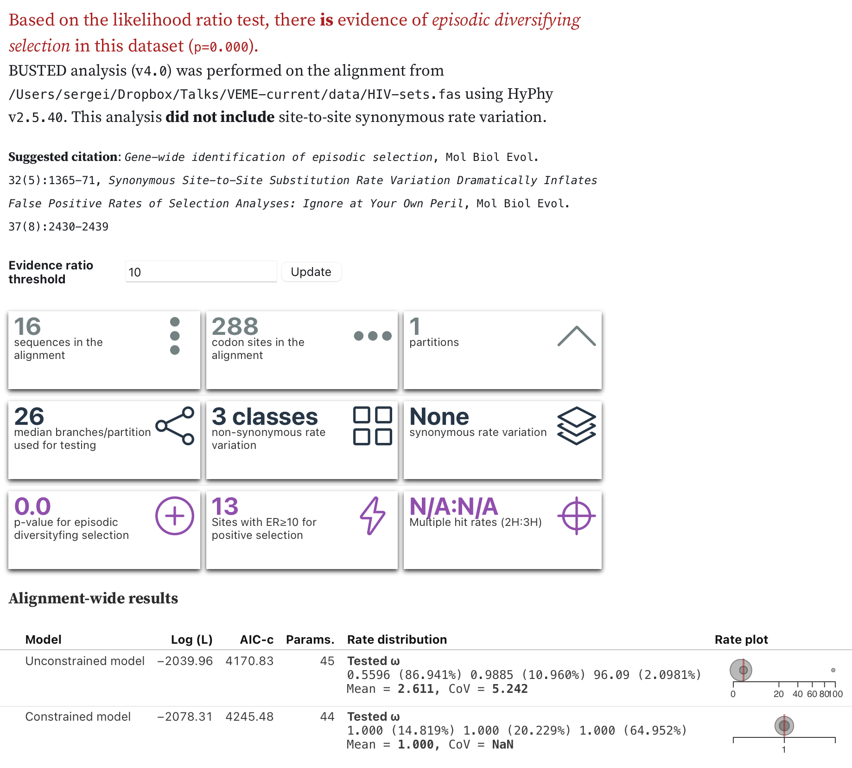
Gene-wide selection analysis using a branch-site method (BUSTED), HIV-1 env
hyphy busted --srv No --alignment data/HIV-sets.nex --starting-points 5
Produces HIV-sets.nex.BUSTED.json file
View in http://vision.hyphy.org/BUSTED or
https://observablehq.com/@spond/busted
Murrell et al | Mol. Biol. Evol | 32(5) | 1365–1371

Slide 62
BUSTED inference
Because BUSTED is a random-effects method, it pools information across multiple sites and branches to gain power
The cost to this pooling is lack of site-level resolution, i.e., it is not immediately obvious which sites and/or branches drive the signal
Standard ways to extract individual site contributions to the overall signal is to perform a post-hoc analysis, such as empirical Bayes, or “category loading”
For BUSTED, “category loading” is faster and experimentally better
Can also compute exploratory evidence for selection support along individual branches at specific sites
Murrell et al | Mol. Biol. Evol | 32(5) | 1365–1371

Slide 63
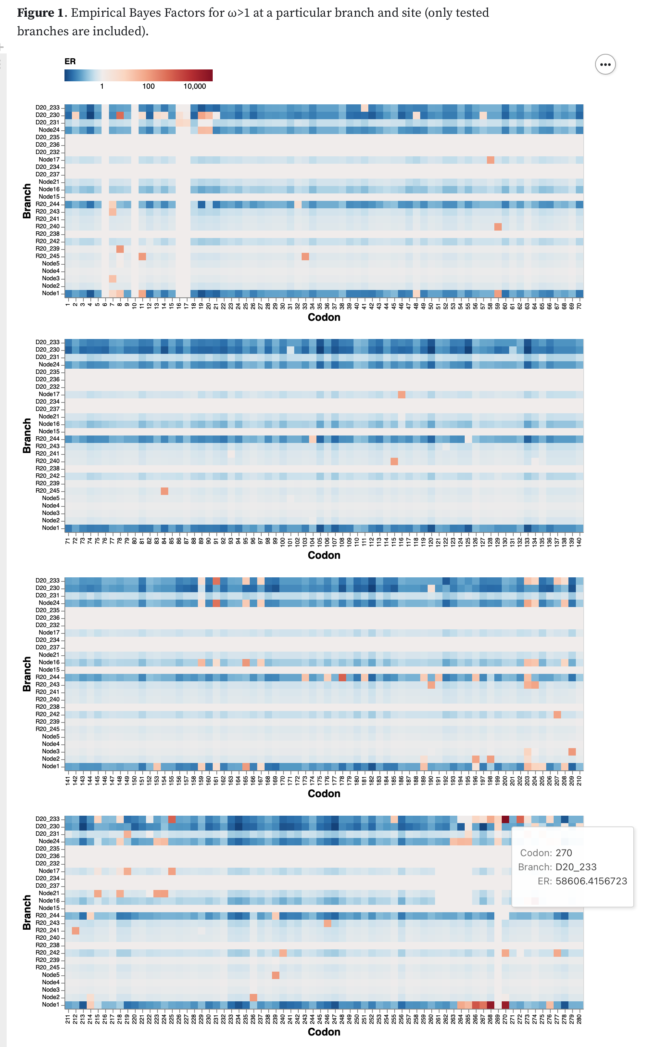
…
Murrell et al | Mol. Biol. Evol | 32(5) | 1365–1371

Slide 64
…
Murrell et al | Mol. Biol. Evol | 32(5) | 1365–1371

Slide 65
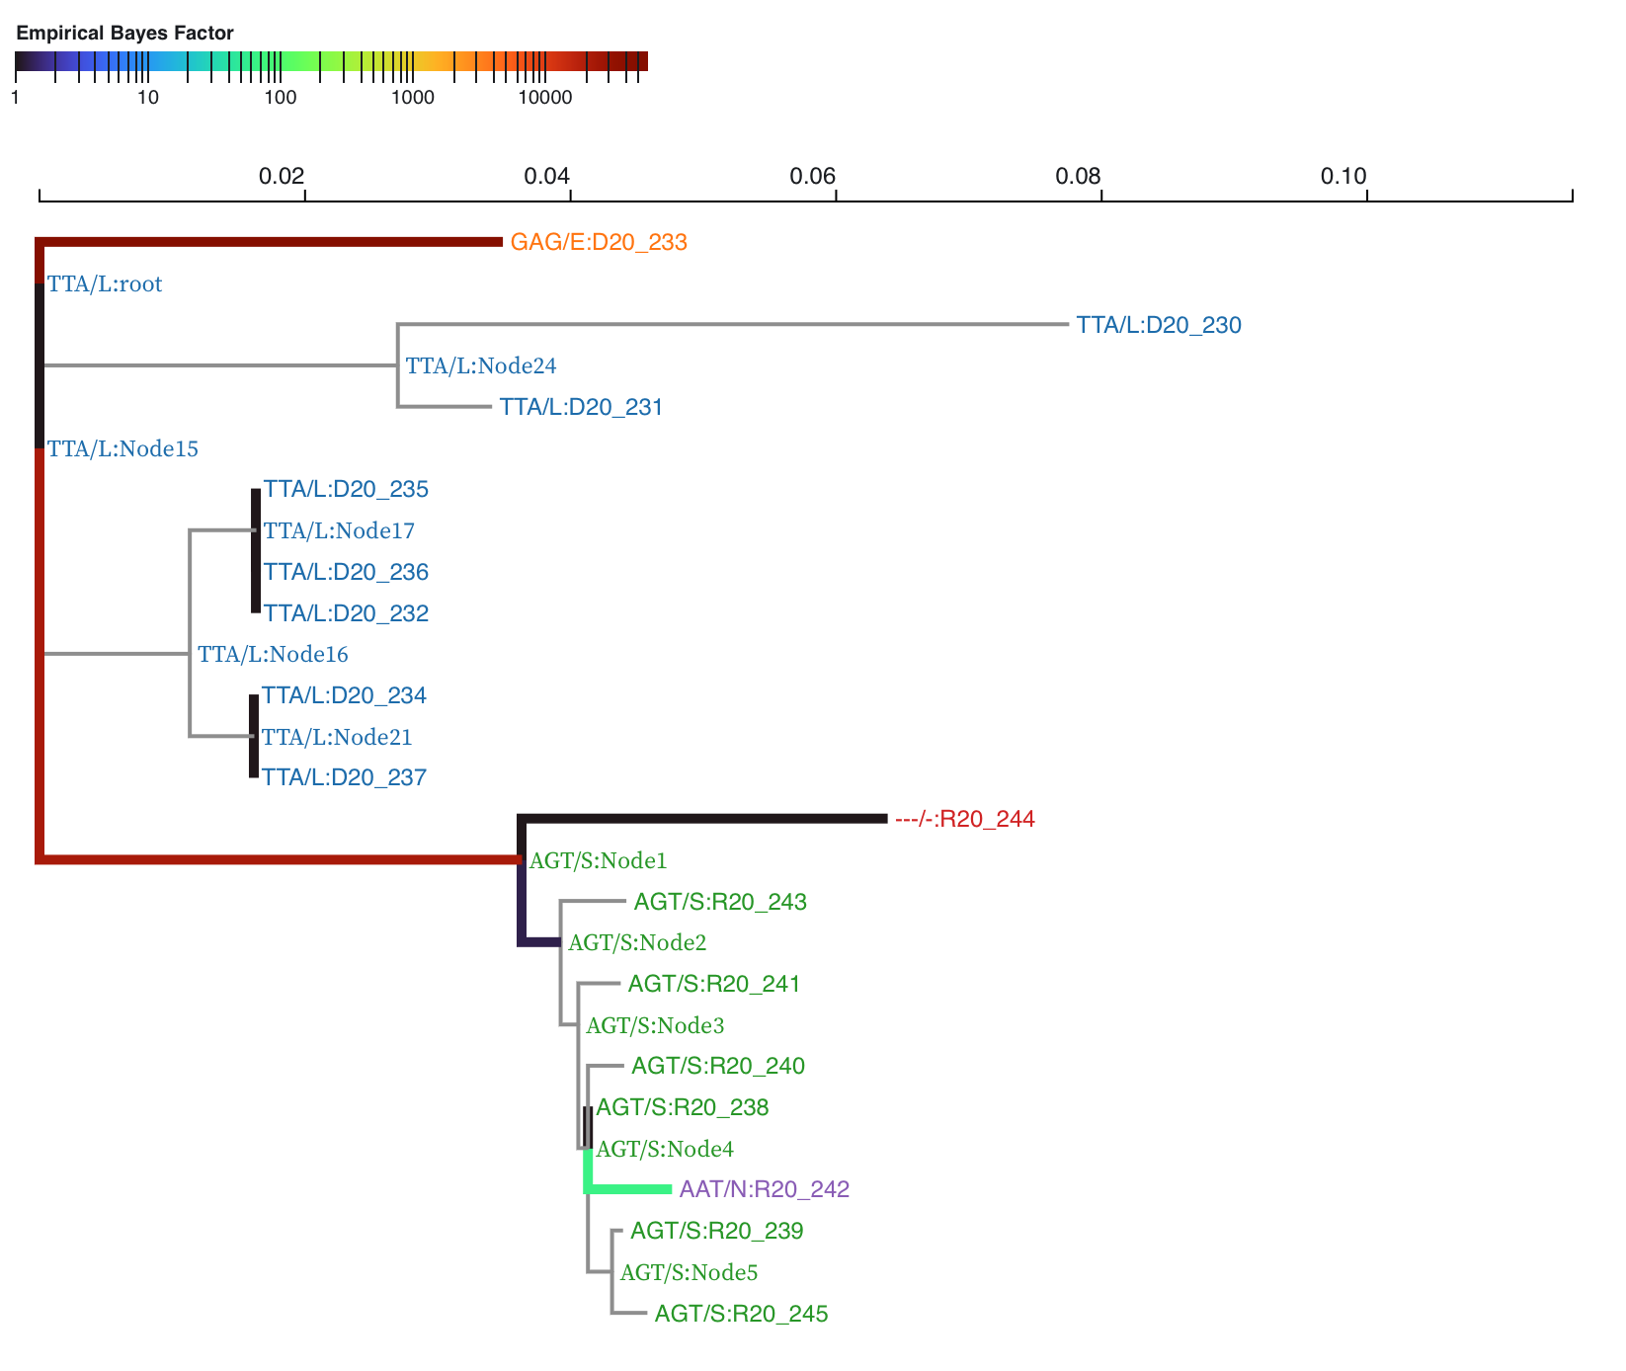
Codon 270

Slide 66
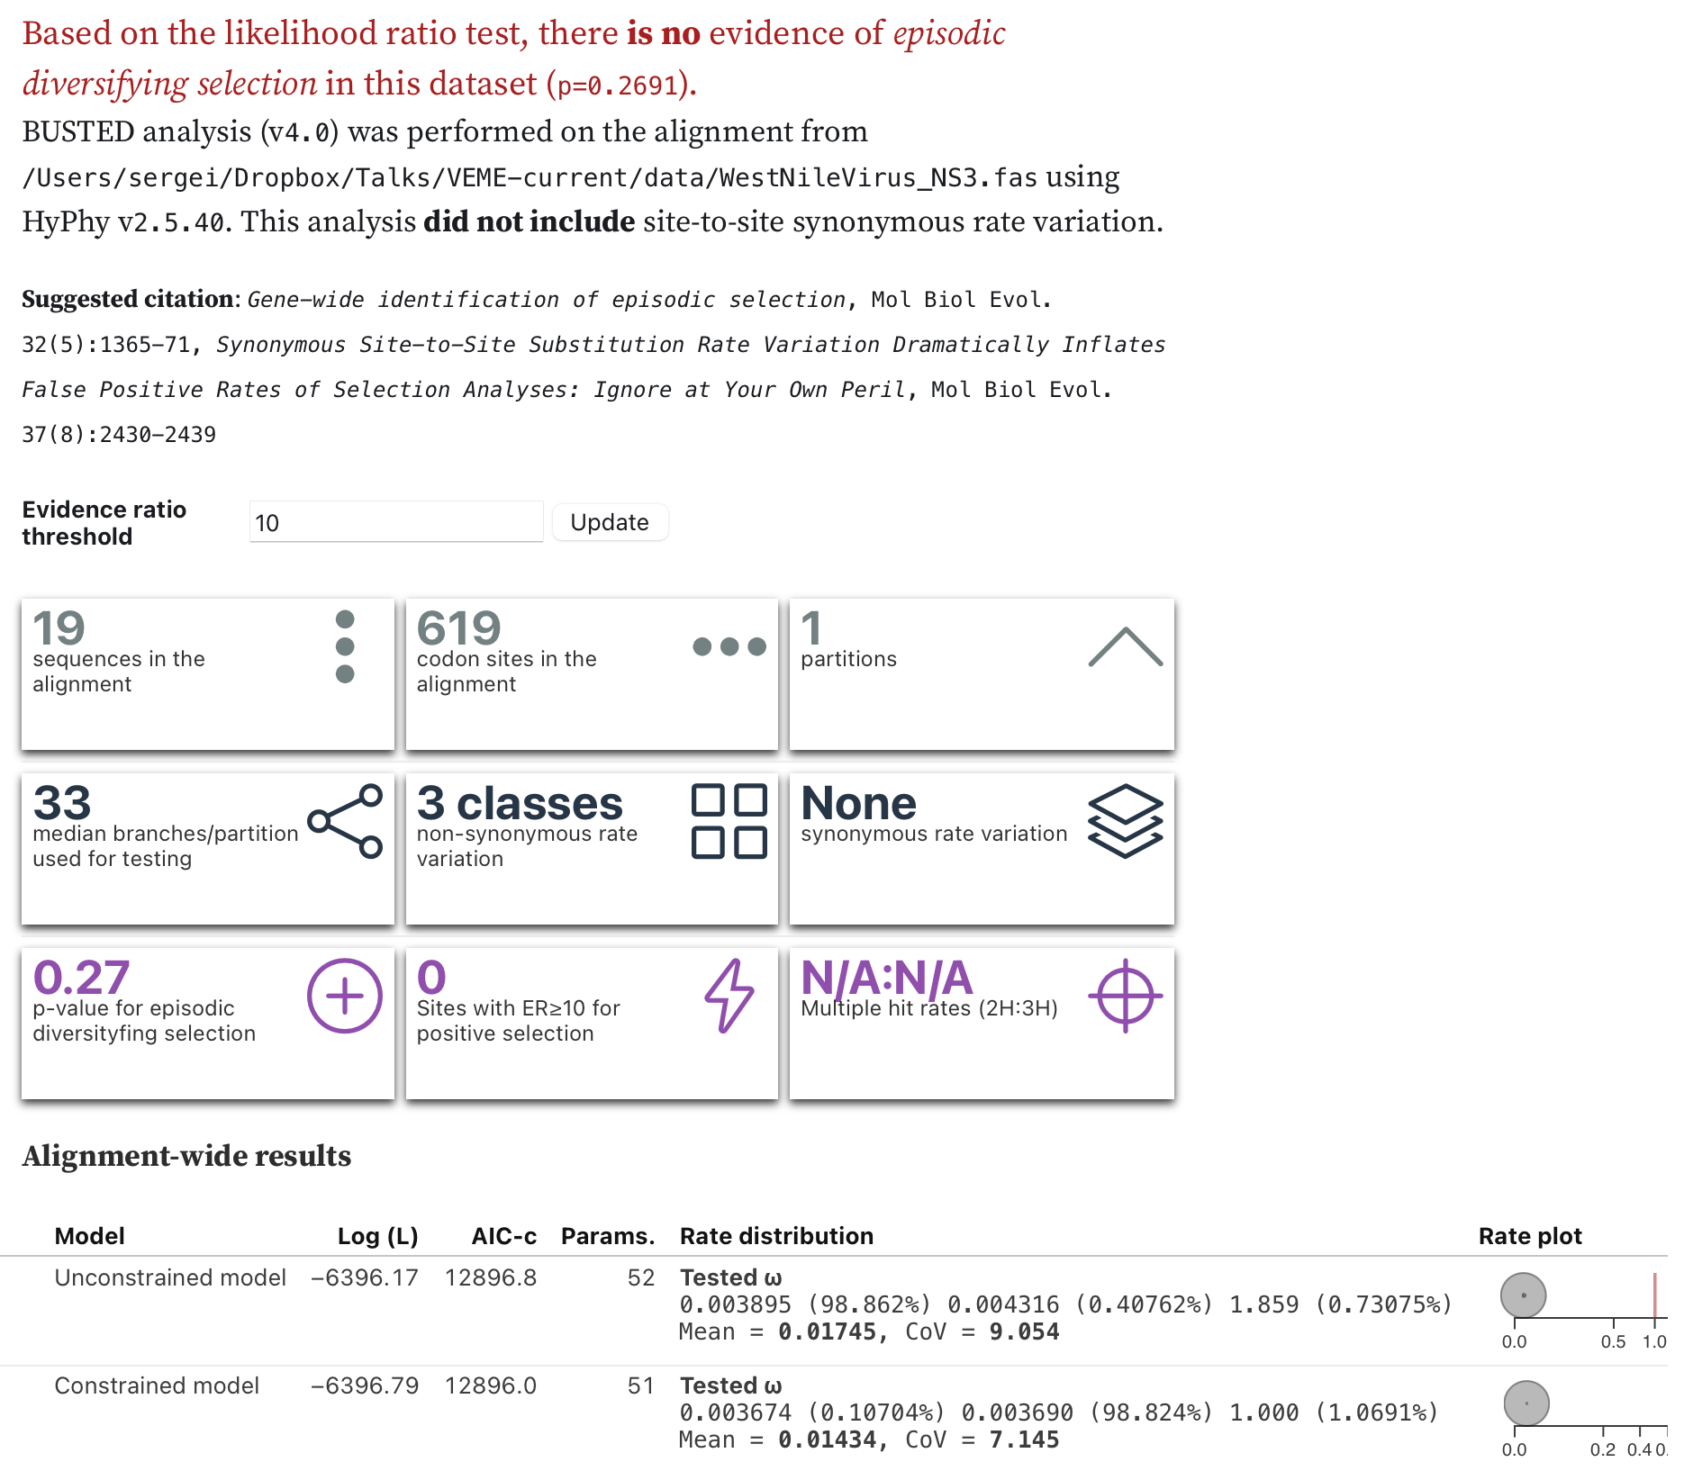
Gene-wide selection analysis using a branch-site method (BUSTED), WNV NS3
hyphy busted --srv No --alignment data/WestNileVirus_NS3.fna --starting-points 5
Produces
WestNileVirus_NS3.fna.BUSTED.json file
View in http://vision.hyphy.org/BUSTED
Murrell et al | Mol. Biol. Evol | 32(5) | 1365–1371

Slide 67
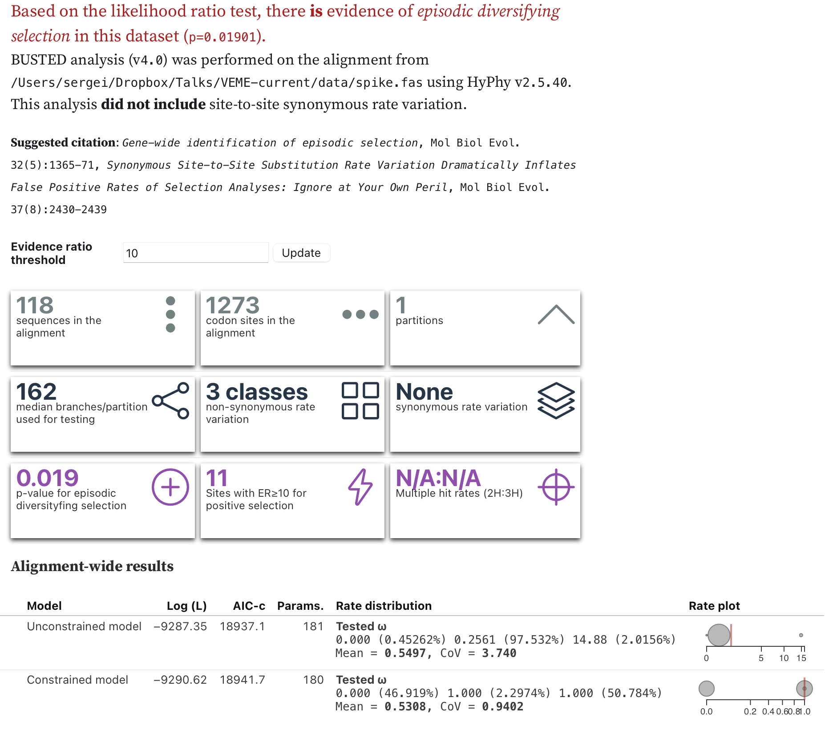
Gene-wide selection analysis using a branch-site method (BUSTED), SARS-CoV-2 spike
hyphy busted --srv No --alignment data/spike.fas --tree data/spike.tree --starting-points 5
Produces spike.fas.BUSTED.json file
View in http://vision.hyphy.org/BUSTED
Murrell et al | Mol. Biol. Evol | 32(5) | 1365–1371

Slide 68
BUSTED analysis
West Nile Virus NS3 protein
No statistical support for selection; ML point estimate allocates a small proportion of sites (~1%) to the selected group (dN/dS ~ 2)
The rest of the gene is very strongly conserved (dN/dS = 0.004)
HIV-1 transmission pair
Very strong evidence of strong episodic diversification (dN/dS ~ 100) on a small proportion of sites (2%)
The rest of the gene evolves with weak purifying selection (dN/dS = 0.6-0.7)
SARS-CoV-2 spike
Evidence of episodic diversification (dN/dS ~ 15) on a small proportion of sites (~2%)
Most of the rest of the gene evolves with purifying selection (dN/dS = 0.2)
Murrell et al | Mol. Biol. Evol | 32(5) | 1365–1371

Slide 69
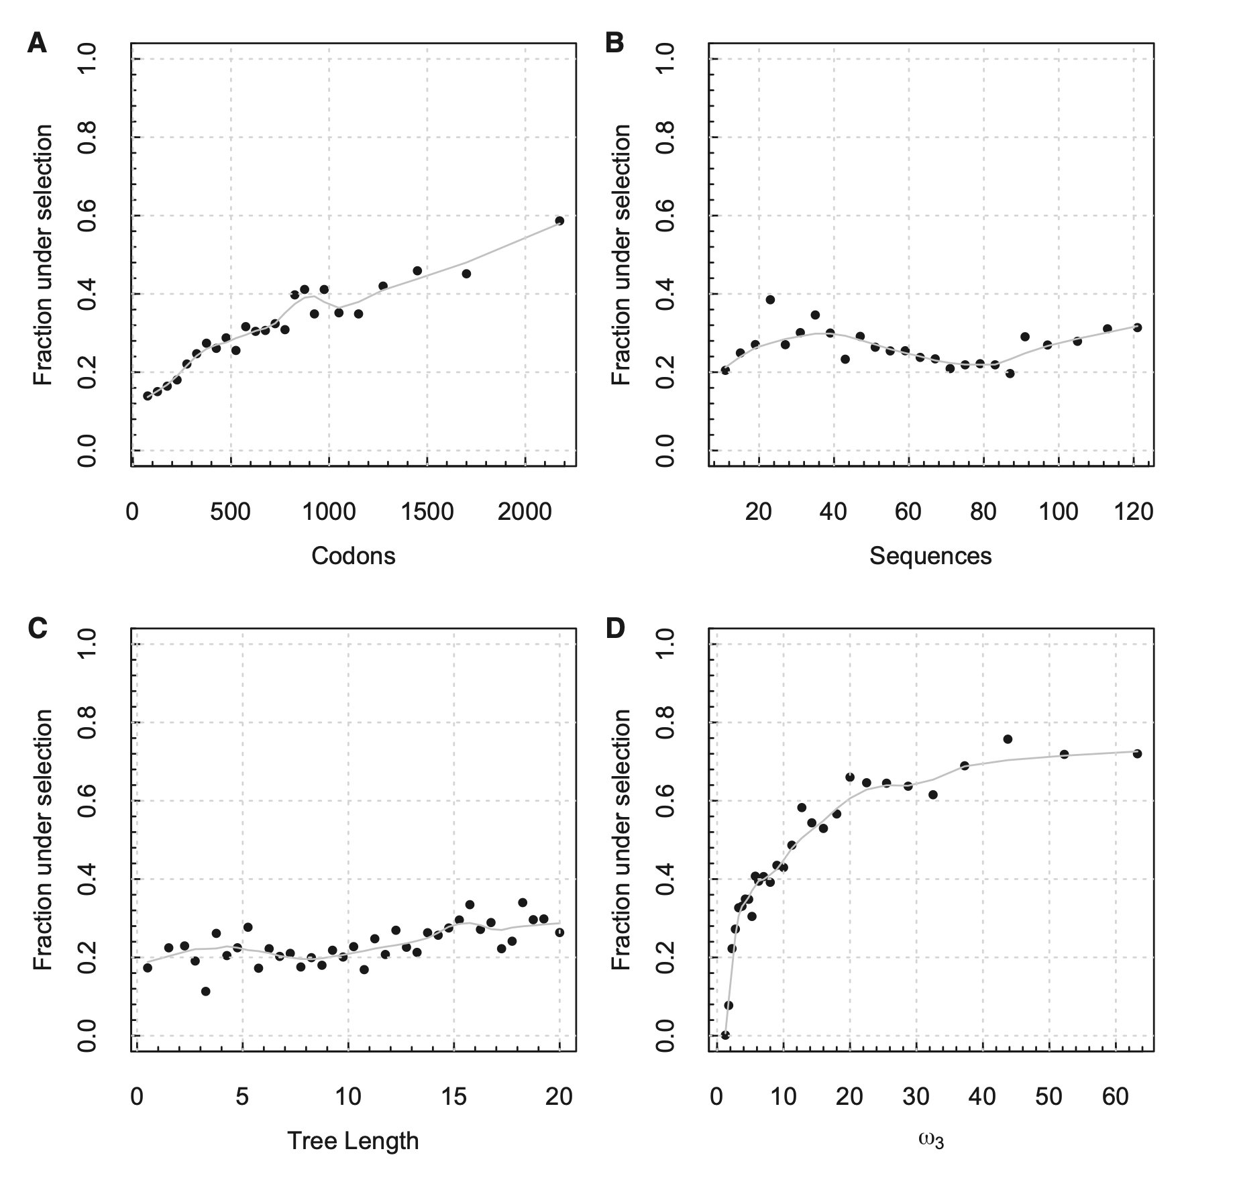
Where does the power come from for BUSTED?
An analysis of ~9,000 curated gene alignments from selectome.unil.ch
⬆︎(longer genes)
larger sample size
⬌ (# taxa)
for comparable taxa ranges
⬌ (divergence)
for comparable taxa ranges
⬆︎(selection strength)
bigger effect size
Murrell et al | Mol. Biol. Evol | 32(5) | 1365–1371

Slide 70
Any questions on the previous material?
We covered the following methods in HyPhy: FitMG94, BUSTED
Which estimates a mean gene-wide dN/dS (FitMG94)
Or estimates dN/dS through a branch-site method (BUSTED)

Slide 71
Which branches are under selection?
Branch 1
Branches
Sites
3-rate fit
 | For each image row, is there a significant proportion of bright pixels, once the column has been reduced to N colors only?
 | [aBSREL]: at a given branch, each site is a draw from an N-bin (dN/dS) distribution, which is inferred from all data for the branch. Test if there is a proportion of sites with dN/dS > 1 (LRT). N is derived adaptively from the data.

Slide 72
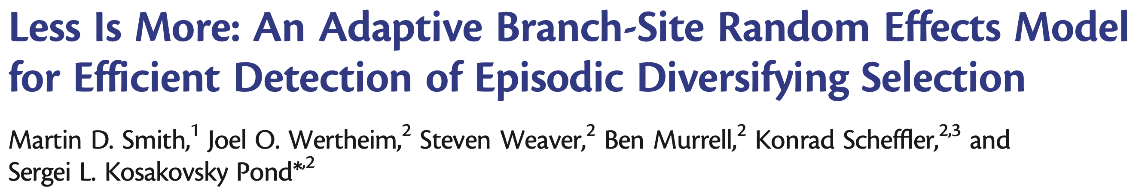
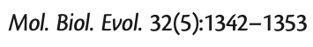
Best-in-class power
Able to detect episodes of selection, not just selection on average at a branch
Does not make unrealistic assumptions for tractability, improves statistical behavior
Sample size is ~sites, branch level rate estimates could be imprecise
Cannot reliably estimate which individual sites are subject to selection
Exploratory testing of all branches leads to loss of power for large data sets (multiple test correction)

Slide 73
Fix the tree; estimate and fix some of the nuisance model parameters that are shared by all branches (GTR biases, frequency counts)
Fit a simple baseline model (one ω per branch); use this model to get initial guesses for all other parameters
Perform a greedy step-up procedure (like forward variable selection in regression models, but not as statistically bad)
For each branch (longest first) try two ω rate classes, then three ω rate classes etc, until no more goodness-of-fit improvement (AIC-c)
Fix the number of rates and move on to the next longest branch
Perform selection testing on the overall model (different number of ω classes on branches), using the likelihood ratio test
Each branch specified a priori (could be all branches)
Appropriate multiple testing correction

Slide 74
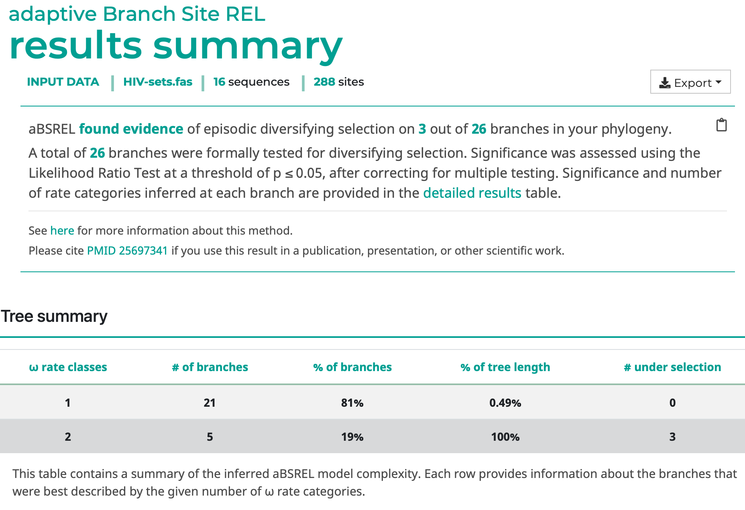
HIV-1 env
hyphy absrel --alignment data/HIV-sets.nex

Slide 75
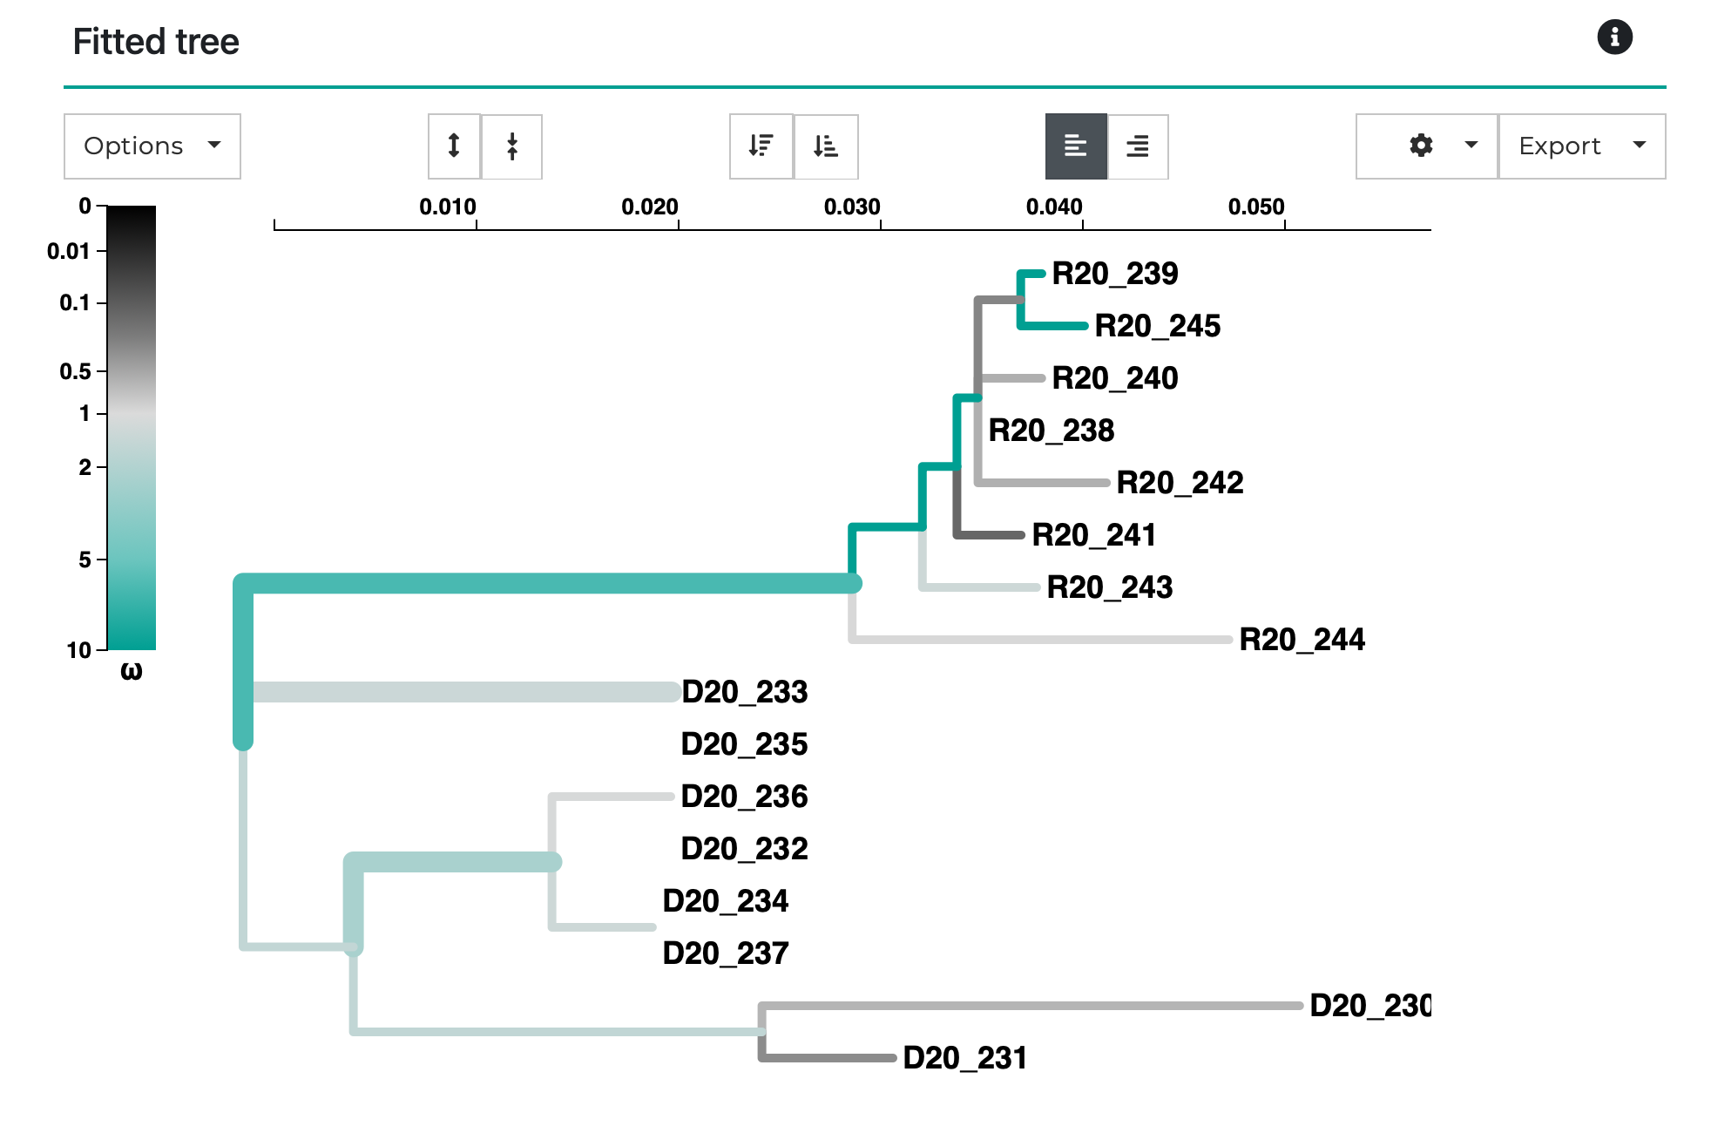
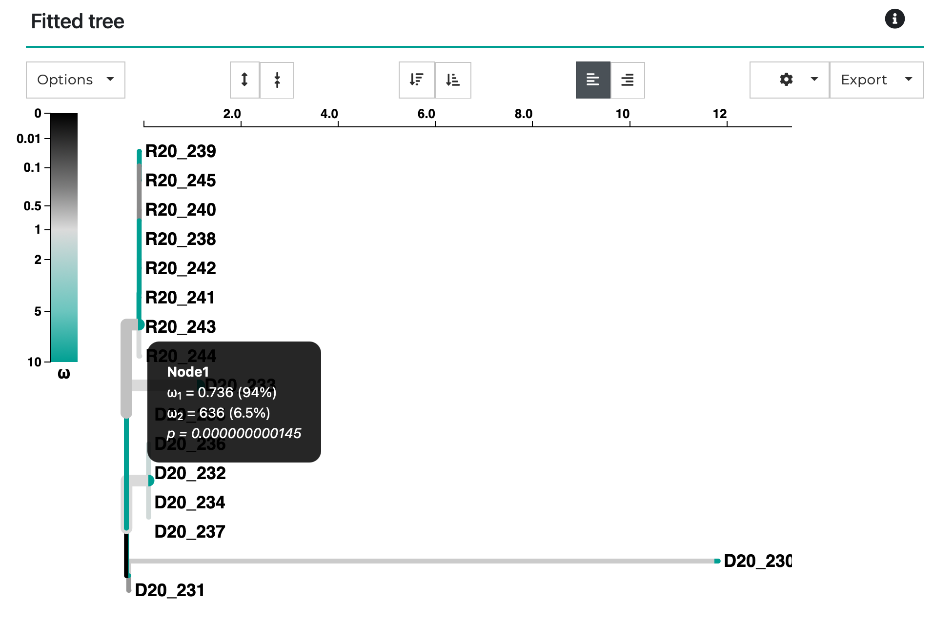
HIV-1 env
Transmission
Transmission
One dN/dS per branch
Adaptive dN/dS per branch

Slide 76
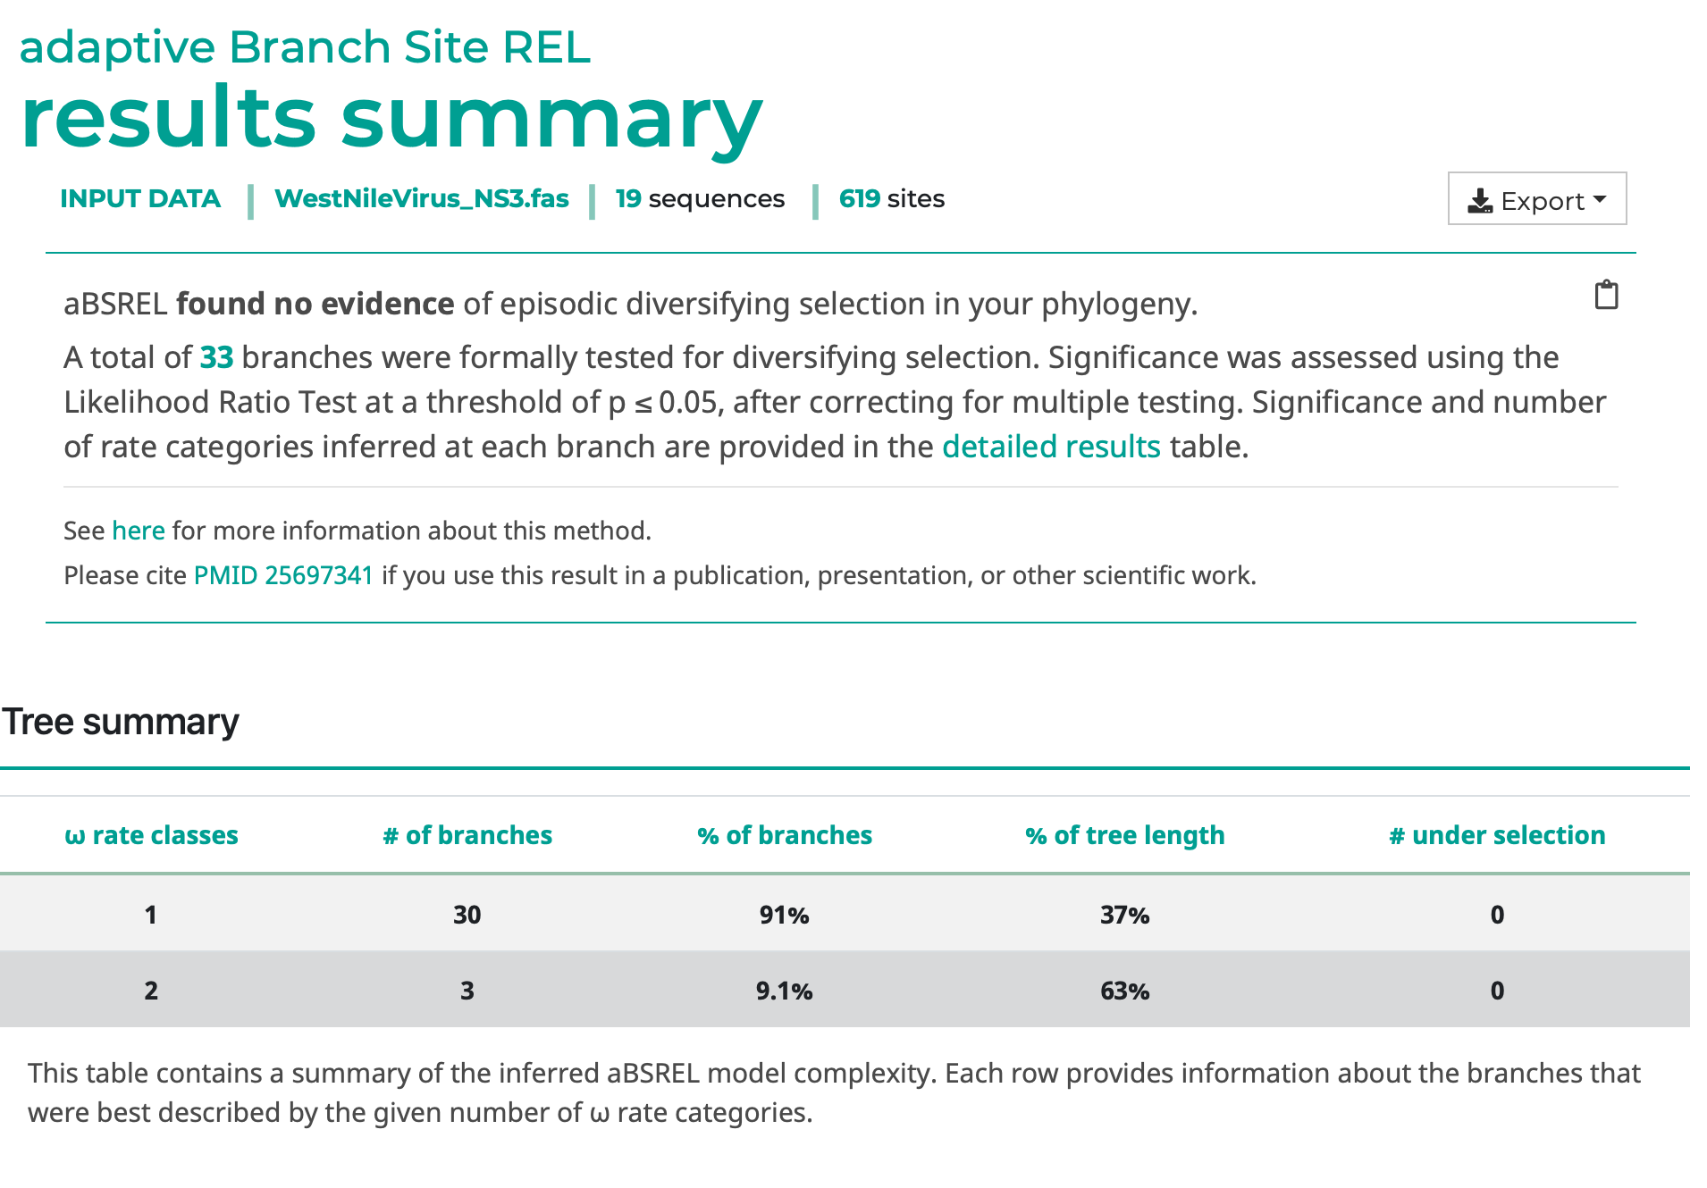
WNV NS3
hyphy absrel --alignment data/WestNileVirus_NS3.fna

Slide 77
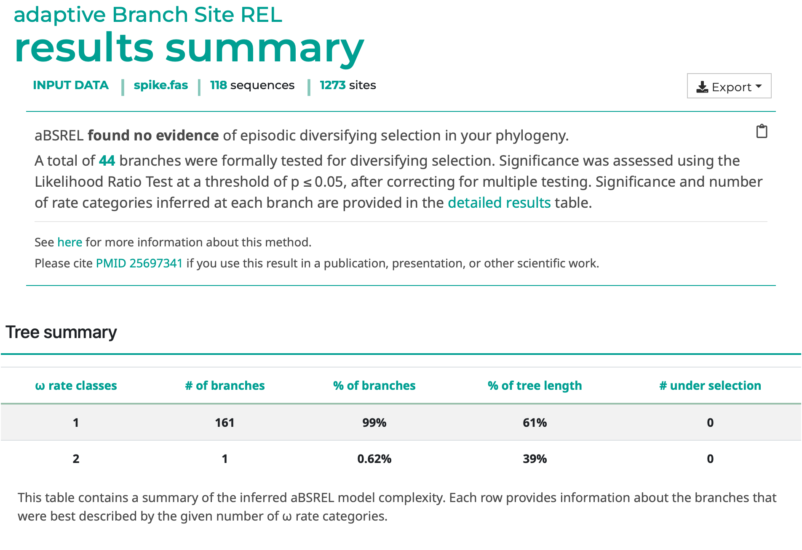
SARS-CoV-2 spike
hyphy absrel --alignment data/spike.fas --tree data/spike.tree --branches Internal

Slide 78
aBSREL analysis
West Nile Virus NS3 protein
91% branches can be explained with simple (single dN/dS) models
3 branches (9%, 60% of tree length) have evidence of multiple dN/dS rate classes over sites, but none with significant proportions of sites with dN/dS > 1
HIV-1 transmission pair
76% branches can be explained with simple (single dN/dS) models
5 branches (24%, ~100% of tree length) have evidence of multiple dN/dS rate classes over sites
3 branches have small (1-7%), but statistically significant (p<0.05, multiple testing corrected) proportions of sites with dN/dS > 1, including the transmission branch
SARS-CoV-2 spike
All but one branch can be explained with simple (single dN/dS) models
1 long terminal branch (~34% of tree length) has evidence of multiple dN/dS rate classes over sites
No evidence of branch level selection on internal branches.

Slide 79
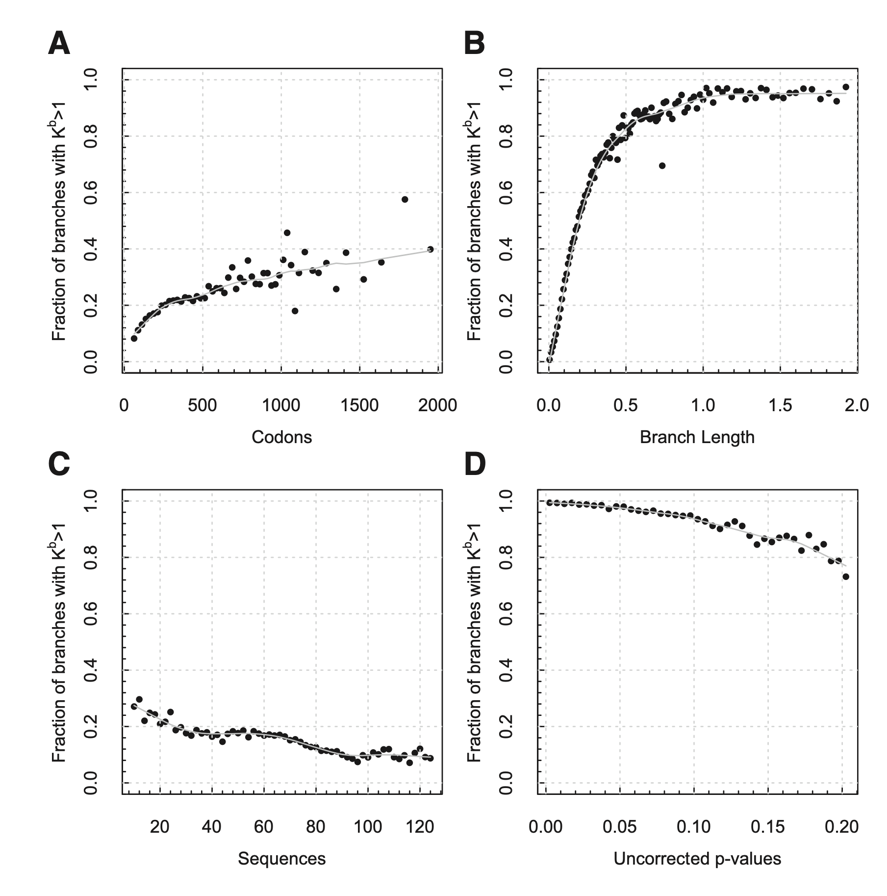
Correlates of evolutionary complexity
An analysis of ~9,000 curated gene alignments from selectome.unil.ch
⬆︎(longer genes)
larger sample size
⬆︎(branch length)
increased process complexity
⬇︎ (#taxa)
for a fixed taxon range
⬆︎(test signal)
model resolution/effect

Slide 80
Unanticipated effects of bad modeling assumptions
Models that fail to account for significant shifts in selective pressures through lineages also significantly underestimate branch lengths
An instructive example is long-range molecular dating of pathogens, where recent isolates (e.g., 30-50 years of sampling) are used to extrapolate the date when a particular pathogen had emerged
This creates the situation when terminal branches in the tree have relatively high dN/dS (within-host level evolution), which deep interior branches have very low dN/dS (long term conservation)

Slide 81
Using models that do not vary selection pressure across lineages yields a patently false “too young” estimate for the origin of measles (about 600 years ago)
This estimate is refuted by clear historical records which suggest that measles is at least 1,500-5,000 years old
This includes a treatise by a Persian physician Rhazes about differential diagnosis of measles and smallpox published circa 600 AD.
Same patterns found for corona-viruses, ebola, avian influenza and herpesvirus
Wertheim and Pond (2011) Mol Biol Evol. 28(12):3355-65

Slide 82
Questions about the previous material?
We covered the aBSREL method, which detects episodes of selection across branches in your phylogeny.

Slide 83
Which sites are under selection?
Murrell et al 2012
Site 1
2-rate fit
Branches
Sites
 | For each image column, is there a significant proportion of bright pixels, once the column has been reduced to 2 colors only?
 | [MEME]: at a given site, each branch is a draw from a 2-bin (dS, dN) distribution, which is inferred from that site only. Test if there is a proportion of branches with dN>dS (LRT)

Slide 84

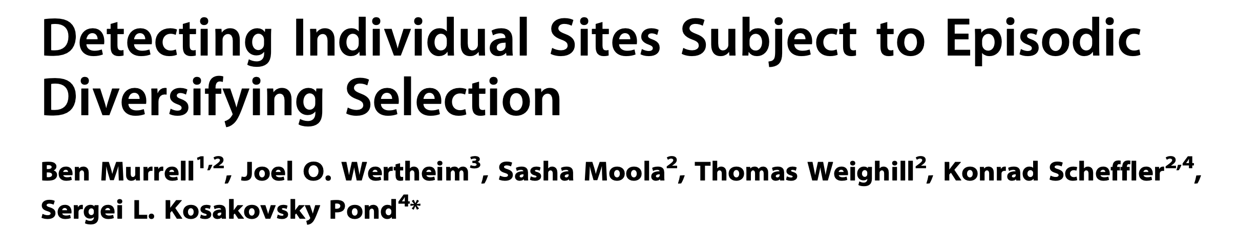
Best-in-class power
Able to detect episodes of selection, not just selection on average at a site
Embarrassingly parallel (farm out each site), so runs reasonably fast
Sample size is ~sequences, site level rate estimates imprecise
Cannot estimate which individual branches are subject to selection with any precision
Does not scale especially well with the number of sequences
Murrell et al | PLoS Genet 8(7): e1002764

Slide 85
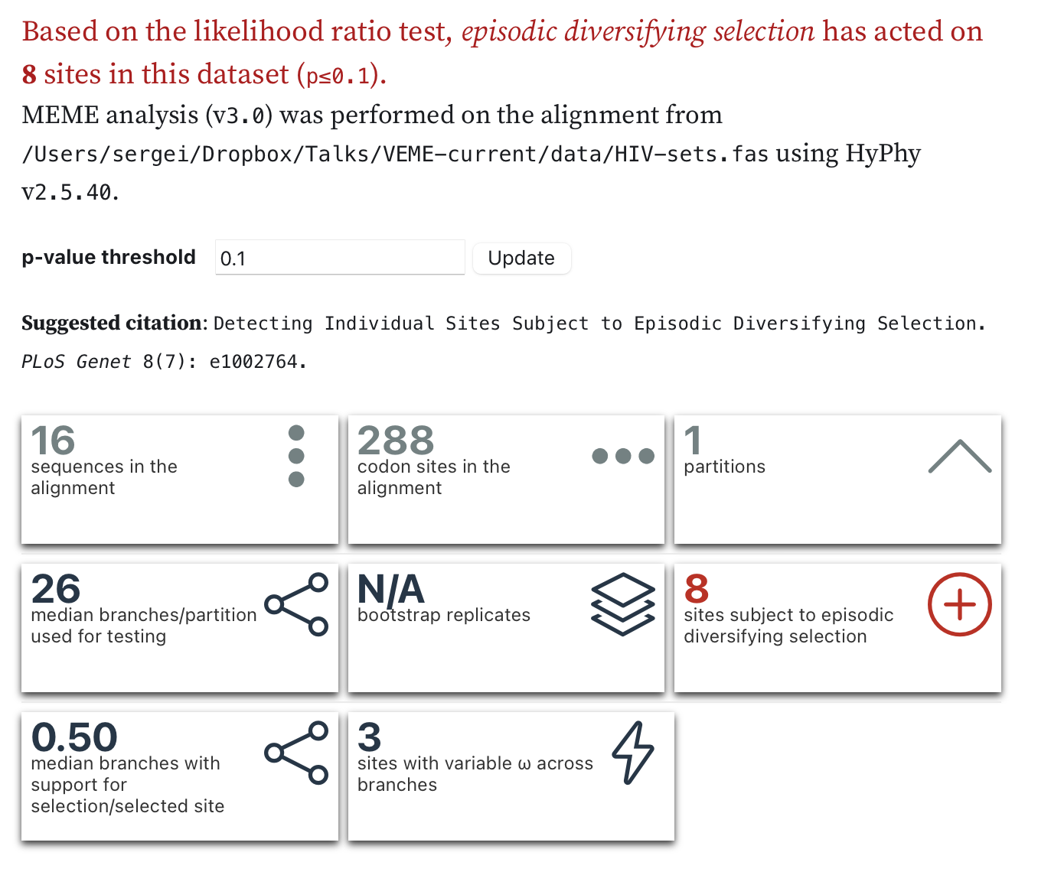
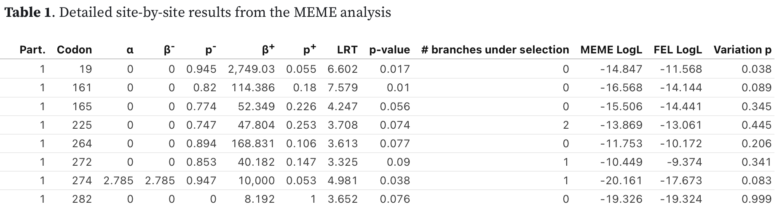
https://observablehq.com/@spond/meme
HIV-1 env
hyphy meme --alignment data/HIV-sets.nex

Slide 86
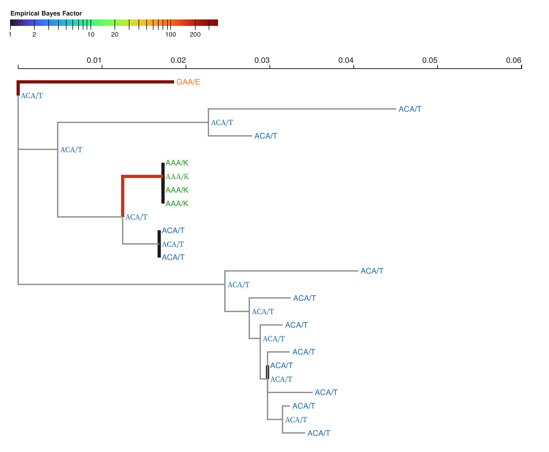
Where in the tree is there evidence for selection?
Can use exploratory Empirical Bayes Factor analysis to find “hotspots”
Not a “strict” statistical test!

Slide 87
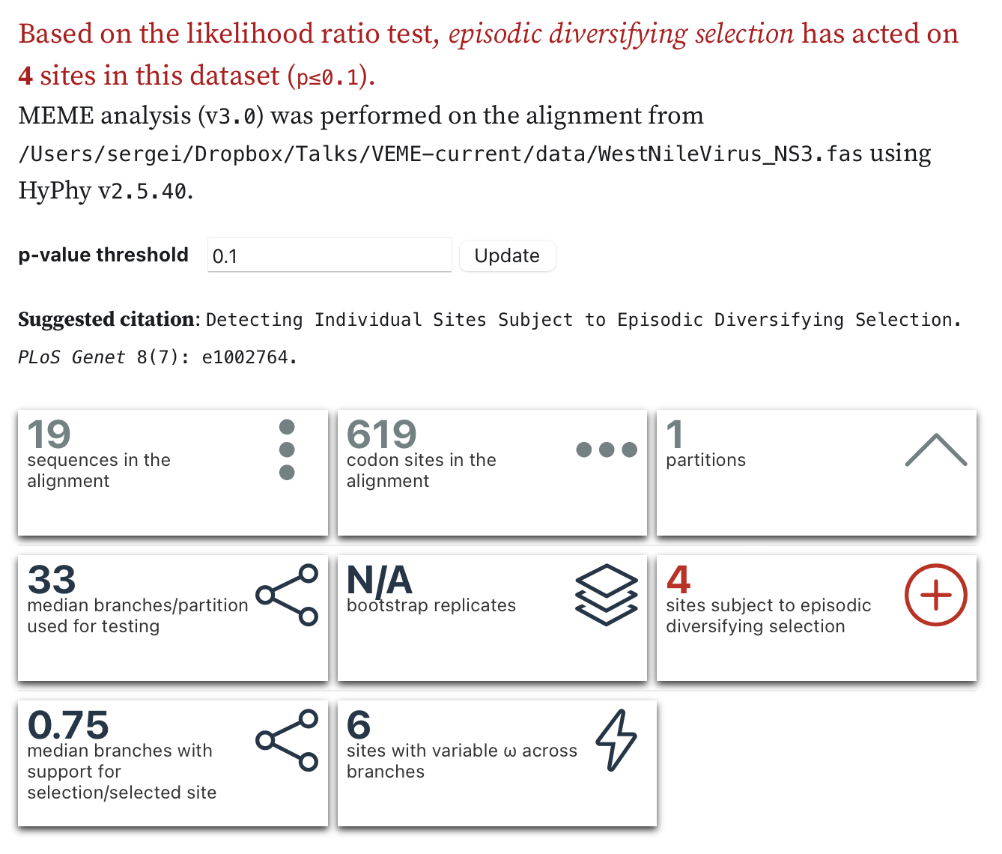
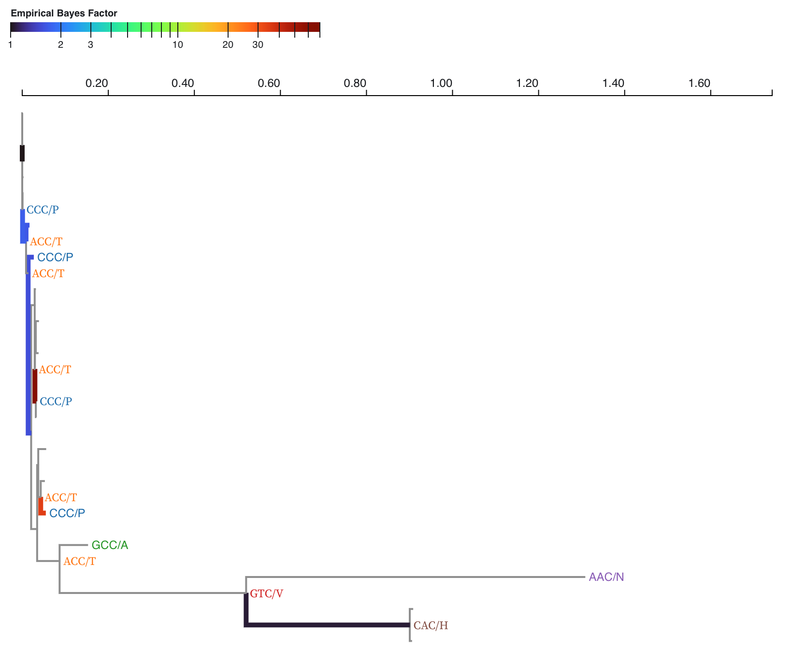
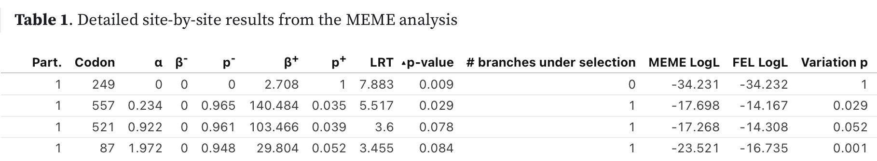
WNV NS3
hyphy meme --alignment data/WestNileVirus_NS3.fna

Slide 88
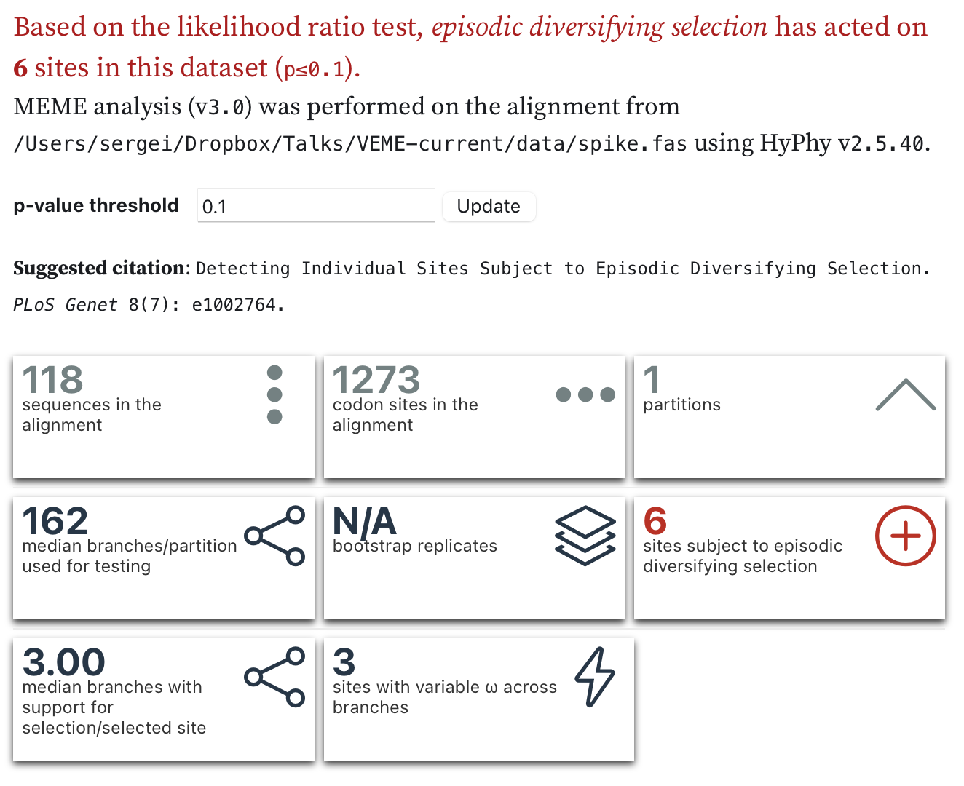
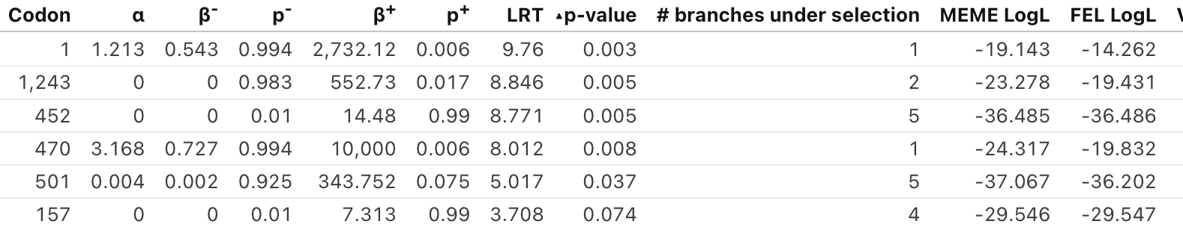
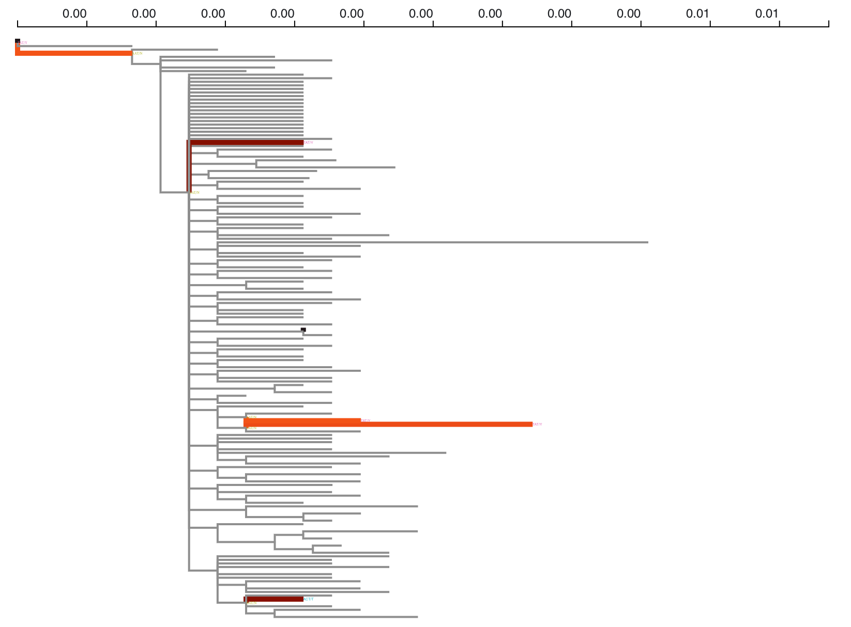
SARS CoV-2 Spike
hyphy meme --alignment data/spike.fas --tree data/spike.tree

Slide 89
Interpreting dN/dS for intra-host and intra-species pathogen
SARS CoV-2 Spike
dN/dS can be estimated for all sorts of sequence data (e.g., it has been done for cancer SNP data)
Traditional interpretation of dN/dS is based on the assumption that substitution ~ fixation
Not the same for intra-species / intra-host pathogens
Much of variation is due to polymorphism, or even dead-end mutations
This is because selection has not had a chance to “filter” mutations (except for patently deleterious ones)
This often manifests as differences in selective “regimes” between tips and internal branches

Slide 90

Partition a pathogen tree into terminal and internal branches
Terminal branches potentially include “dead-end” lineages, i.e. those which are maladaptive
Internal branches include at least one “transmission” (intra-species) or “replication” (intra-host) events: stronger action of selection
Focusing on a subset of branches can allow one to interpret dN/dS more precisely

Slide 91
SARS CoV-2 Spike
Internal Branches Only
| Codon | Partition | alpha | beta+ | p+ | LRT |Episodic selection detected?| # branches |Most common codon substitutions at this site|
|:----------:|:----------:|:----------:|:----------:|:----------:|:----------:|:--------------------------:|:----------:|:------------------------------------------:|
| 367 | 1 | 0.000 | 98.114 | 0.459 | 9.062 | Yes, p = 0.0047 | 2 | [2]Gtc>Ttc |
| 439 | 1 | 0.000 | 35.271 | 1.000 | 4.990 | Yes, p = 0.0379 | 1 | [1]aaC>aaA |
| 452 | 1 | 0.000 | 30.877 | 1.000 | 5.520 | Yes, p = 0.0288 | 1 | [4]cTg>cGg|[1]Ctg>Atg |
| 477 | 1 | 0.000 | 51.490 | 0.460 | 4.334 | Yes, p = 0.0532 | 1 | [1]aGc>aAc |
| 501 | 1 | 0.000 | 271.405 | 0.145 | 3.460 | Yes, p = 0.0839 | 1 | [3]Aat>Tat|[1]aAt>aCt,Tat>Aat |
| 614 | 1 | 0.000 | 49.307 | 0.464 | 3.187 | Yes, p = 0.0968 | 1 | [1]Gat>Aat,gGt>gAt |
hyphy meme --alignment data/spike.fas --tree data/spike.tree --branches Internal

Slide 92
MEME results
West Nile Virus NS3 protein
Four sites (incl. 249, previously reported) with significant evidence of episodic (or pervasive) diversifying selection.
HIV-1 transmission pair
Nine sites with significant evidence of episodic (or pervasive) diversifying selection. HIV-1 transmission pair
SARS-CoV-2 spike (all)
Six sites with significant evidence of episodic (or pervasive) diversifying selection.
SARS-CoV-2 spike (internal)
Six sites with significant evidence of episodic (or pervasive) diversifying selection.

Slide 93
Questions about the previous material?
We covered the MEME method:
which detects episodes of selection and is used as a more sensitive method for estimating diversifying selection.

Slide 94
More on site-level selection
Three more methods in HyPhy
Fixed Effects Likelihood (FEL)
A simpler alternative to MEME (looks for pervasive selection)
May be more suited for smaller datasets or datasets of low divergence
Single Likelihood Ancestor Counting (SLAC)
A counting-based approach
Good for data exploration and visualization
Fast Unrestricted Bayesian AppRoximation (FUBAR)
A novel statistical approach for detecting pervasive adaptive evolution on large datasets (scales to 10000s of sequences)

Slide 95
FEL on internal branches of Spike finds most selected sites, including many known to be of functional significance
| Codon | Partition | alpha | beta | LRT |Selection detected?|
|:--------------:|:--------------:|:--------------:|:--------------:|:--------------:|:-----------------:|
| 5 | 1 | 0.000 | 19.047 | 2.891 | Pos. p = 0.0891 |
| 12 | 1 | 0.000 | 20.331 | 2.990 | Pos. p = 0.0838 |
| 18 | 1 | 0.000 | 19.108 | 2.886 | Pos. p = 0.0893 |
| 138 | 1 | 0.000 | 26.726 | 2.738 | Pos. p = 0.0980 |
| 367 | 1 | 0.000 | 44.298 | 9.049 | Pos. p = 0.0026 |
| 439 | 1 | 0.000 | 34.504 | 4.989 | Pos. p = 0.0255 |
| 452 | 1 | 0.000 | 30.455 | 5.519 | Pos. p = 0.0188 |
| 477 | 1 | 0.000 | 23.695 | 4.327 | Pos. p = 0.0375 |
| 501 | 1 | 0.000 | 38.294 | 3.319 | Pos. p = 0.0685 |
| 570 | 1 | 0.000 | 21.078 | 3.049 | Pos. p = 0.0808 |
| 614 | 1 | 0.000 | 22.071 | 3.101 | Pos. p = 0.0783 |
| 681 | 1 | 0.000 | 18.297 | 2.820 | Pos. p = 0.0931 |
| 1176 | 1 | 0.000 | 21.975 | 3.040 | Pos. p = 0.0812 |
hyphy fel --alignment data/spike.fas --tree data/spike.tree --branches Internal

Slide 96
More accurate testing via parametric bootstrap
P-values for MEME/FEL etc are derived from asymptotic approximations (large N)
Not clear how well these hold for smaller and low-divergence datasets
Can use a much slower simulation based method to derive more accurate p-values at each site
Can result both in improved power and lower rates of false positives

Slide 97
FEL on internal branches of Spike finds most selected sites
| Codon | Partition | alpha | beta | LRT |Selection detected?|
|:--------------:|:--------------:|:--------------:|:--------------:|:--------------:|:-----------------:|
| 1 | 1 | 10000.000 | 0.075 | 1.004 | Neg. p = 0.0099 |
| 5 | 1 | 0.000 | 19.044 | 2.890 | Pos. p = 0.0297 |
| 12 | 1 | 0.000 | 20.323 | 2.989 | Pos. p = 0.0297 |
| 13 | 1 | 0.000 | 23.877 | 2.589 | Pos. p = 0.0396 |
| 18 | 1 | 0.000 | 19.110 | 2.885 | Pos. p = 0.0396 |
| 49 | 1 | 0.000 | 22.768 | 2.519 | Pos. p = 0.0594 |
| 69 | 1 | 0.000 | 22.573 | 2.464 | Pos. p = 0.0396 |
| 138 | 1 | 0.000 | 26.821 | 2.736 | Pos. p = 0.0693 |
| 177 | 1 | 10000.000 | 0.000 | 1.187 | Neg. p = 0.0099 |
| 245 | 1 | 0.000 | 22.499 | 2.501 | Pos. p = 0.0792 |
| 367 | 1 | 0.000 | 44.535 | 9.044 | Pos. p = 0.0099 |
| 439 | 1 | 0.000 | 34.481 | 4.986 | Pos. p = 0.0099 |
| 452 | 1 | 0.000 | 30.321 | 5.518 | Pos. p = 0.0099 |
| 477 | 1 | 0.000 | 23.678 | 4.325 | Pos. p = 0.0297 |
| 501 | 1 | 0.000 | 38.373 | 3.317 | Pos. p = 0.0297 |
| 570 | 1 | 0.000 | 21.039 | 3.047 | Pos. p = 0.0594 |
| 614 | 1 | 0.000 | 22.215 | 3.099 | Pos. p = 0.0594 |
| 681 | 1 | 0.000 | 18.344 | 2.819 | Pos. p = 0.0297 |
| 701 | 1 | 0.000 | 20.245 | 1.998 | Pos. p = 0.0792 |
| 716 | 1 | 0.000 | 25.450 | 2.349 | Pos. p = 0.0792 |
| 769 | 1 | 0.000 | 28.107 | 2.470 | Pos. p = 0.0693 |
| 854 | 1 | 0.000 | 25.908 | 2.506 | Pos. p = 0.0495 |
| 941 | 1 | 0.000 | 25.251 | 2.344 | Pos. p = 0.0891 |
| 1118 | 1 | 3.081 | 27.290 | 2.023 | Pos. p = 0.0495 |
| 1176 | 1 | 0.000 | 22.141 | 3.039 | Pos. p = 0.0297 |
| 1237 | 1 | 10000.000 | 0.151 | 0.876 | Neg. p = 0.0099 |
| 1248 | 1 | 0.000 | 20.075 | 2.336 | Pos. p = 0.0891 |
CAUTION: A VERY TIME CONSUMING ANALYSIS (SEVERAL HOURS)
hyphy fel --alignment data/spike.fas --tree data/spike.tree --branches Internal --output Spike-pbs.FEL.json --resample 100

Slide 98

Asymptotic p-value is too conservative in this case for most sites

Slide 99
Obtaining site-level dN/dS estimates with FEL
dN/dS estimates at individual sites are not precise
They are estimated from relatively small samples
Precision improves with the number of sequences and divergence levels
One approach to correct for this is to compute approximate site-level confidence intervals.

Slide 100
| Codon | Partition | alpha | beta | LRT |Selection detected?|dN/dS with confidence intervals|
|:--------------:|:--------------:|:--------------:|:--------------:|:--------------:|:-----------------:|:-----------------------------:|
| 2 | 1 | 1.843 | 0.000 | 7.521 | Neg. p = 0.0061 | 0.000( 0.00- 0.09) |
| 3 | 1 | 0.786 | 0.000 | 3.161 | Neg. p = 0.0754 | 0.000( 0.00- 0.16) |
| 4 | 1 | 2.174 | 0.000 | 10.742 | Neg. p = 0.0010 | 0.000( 0.00- 0.07) |
| 7 | 1 | 1.105 | 0.000 | 7.537 | Neg. p = 0.0060 | 0.000( 0.00- 0.11) |
| 8 | 1 | 0.422 | 0.000 | 3.173 | Neg. p = 0.0749 | 0.000( 0.00- 0.28) |
| 9 | 1 | 1.353 | 0.000 | 8.638 | Neg. p = 0.0033 | 0.000( 0.00- 0.08) |
| 10 | 1 | 1.353 | 0.000 | 8.369 | Neg. p = 0.0038 | 0.000( 0.00- 0.09) |
…
| 247 | 1 | 1.353 | 0.000 | 8.088 | Neg. p = 0.0045 | 0.000( 0.00- 0.10) |
| 248 | 1 | 0.451 | 0.000 | 3.496 | Neg. p = 0.0615 | 0.000( 0.00- 0.28) |
| 249 | 1 | 0.000 | 2.700 | 7.881 | Pos. p = 0.0050 | 10000.000(7599.84-10000.00) |
| 250 | 1 | 0.220 | 0.000 | 2.797 | Neg. p = 0.0945 | 0.000( 0.00- 0.61) |
| 388 | 1 | 0.220 | 0.000 | 2.797 | Neg. p = 0.0945 | 0.000( 0.00- 0.61) |
hyphy fel --alignment data/WestNileVirus_NS3.fna —ci Yes

Slide 101
Mapping substitutions with SLAC
SLAC capable of detecting selection, is fast, but generally lacks power
It provides a number of intuitive metrics for interpreting selection results
SLAC recovers ancestral states and allows one to “map” evolutionary history onto a tree.
hyphy slac --alignment data/spike.fas --tree data/spike.tree --branches Internal

Slide 102


Site 452

Slide 103
Analysis summary
 | WNV NS3 | HIV-1 env | SARS-CoV-2 spike
Gene-wide episodic selection (BUSTED) | No | Yes | Yes
Branch-level selection (aBSREL) | No | Yes, three branches, including transmission | No
Site-level episodic selection (MEME) | Yes, 1 site | Yes, 8 sites | Yes, sites found depend on which branches are included

Slide 104
Questions about the previous material?
We covered the FEL and SLAC selection analyses, site-level methods
Fixed Effects Likelihood (FEL)
A simpler alternative to MEME (looks for pervasive selection)
May be more suited for smaller datasets or datasets of low divergence
Single Likelihood Ancestor Counting (SLAC)
A counting-based approach
Good for data exploration and visualization

Slide 105
It is not unexpected that site-level positive results can occur when a gene-level test does not yield a positive result
Lack of power for the global test: if the proportion of sites under selection is very small, a mixture-model test, like BUSTED, will miss it.
Model violations: MEME supplies much more flexible distributions of dN/dS over sites; compared to alignment-wide k-bin (k=3) BUSTED distribution.
False positives at site-level: our site-level tests have good statistical properties, but each positive site result could be a false positive; FWER correction would make site-level tests too conservative.
Summary: gene-level selection tests need a minimal proportion of sites to be under selection to be powered; site-level tests should not be used to make inferences about gene-level selection.

Slide 106
However, we caution that despite obvious interest in identifying specific branch-site combinations subject to diversifying selection, such inference is based on very limited data (the evolution of one codon along one branch), and cannot be recommended for purposes other than data exploration and result visualization. This observation could be codified as the “selection inference uncertainty principle” — one cannot simultaneously infer both the site and the branch subject to diversifying selection. In this manuscript [MEME], we describe how to infer the location of sites, pooling information over branches; previously [aBSREL] we have outlined a complementary approach to find selected branches by pooling information over sites.
Murrell et al 2012

Slide 107
Purpose-built models
It is tempting to “hack” existing tools to answer questions that they are not designed to answer
A recent example we tackled is a rigorous test for relaxation of selection (or more generally a difference in selective regimes) in a part of the tree, relative to the rest of the tree
Typical approaches have been to estimate dN/dS rations from two sets of branches, and interpret an elevation in dN/dS as evidence of selective constraint relaxation
Two problems with this approach:
An increase in mean dN/dS could also be caused by an intensification of selective forces.
Post-hoc analyses (e.g., estimate branch-level dN/dS and then compare [t-test, etc] them as if they were observed quantities) discard a lot of information (e.g., variance of individual estimates), and make obviously wrong assumptions (e.g., estimates are uncorrelated).

Slide 108



ω→ω^{k}
^{Test for k ≠ 1}
Wertheim et al | Mol Biol Evol.| 32(3):820-32

Slide 109

Comparing alpha vs delta clades in SARS-CoV-2
Are selective pressures on the Delta SARS-CoV-2 clade relaxed or intensified compared to the Alpha clade?
Partition the tree into corresponding clades.
See http://www.hyphy.org/tutorials/CL-prompt-tutorial/#preparing-labeled-phylogenies for how to label phylogenies

Slide 110

hyphy relax --alignment data/AlphaDeltaSpike.fas --tree data/AlphaDeltaSpike.nwk --test Delta --reference Alpha --starting-points 5

Slide 111
Which sites are evolving differentially?
We have established that in the HIV example, donor, recipient, and transmission branches evolve differently.
Can we identify specific sites where this may be occurring?
Why is this of interest?
More generally, given a tree with N sets of branches, we fish to find sites where evolution is different between these N sets, with a degree of statistical significance.
Solution: use a fixed effects method (Contrast-FEL)
For each branch set i, estimate a dN/dS ration (N total ratios)
Test whether or not any of the ratios are different (group test)
For each pair of ratios, test if they are different [ up to N (N-1) / 2 tests ]
Can identify subtle differences among selective pressures.
Molecular Biology and Evolution, Volume 38, Issue 3, March 2021, Pages 1184–1198,

Slide 112

hyphy contrast-fel --alignment data/AlphaDeltaSpike.fas --tree data/AlphaDeltaSpike.tree --branch-set Alpha --branch-set Delta

Slide 113

Branch testing; exploratory vs a priori
aBSREL and BUSTED can test all branches for selection (exploratory), or apply the test to a set of branches defined a priori (e.g. defining a particular biological hypothesis).
For BUSTED, a priori partitioning of branches can increase power, especially if selective regimes are markedly different on different parts of the tree.
For example, BUSTED applied to the HIV dataset where the transmission branch is designated as foreground, found a greater proportion sites under stronger selection on this branch that the rest of the tree (8% vs 1%), and a lower p-value.
 | Background | Foreground
Class 1 | ω = 0.51 p = 0.08 | ω = 0.00 p = 0.92
Class 2 | ω = 0.72 p = 0.91
Class 3 | ω = 116 p = 0.01 | ω = 510 p = 0.08

Slide 114
Task | Test | Site strategy | Branch strategy | Complexity | Effective sample size | Parallelization | Practical # sequences limit
Gene-wide selection | BUSTED | Random Effects | Random Effects | Fixed | ~sites x taxa | SMP | ~2,000
Site-level selection / episodic | MEME | Fixed Effects | Random Effects | Fixed | ~ taxa | SMP/MPI | ~25000 (cluster)
Site-level selection / pervasive | FEL | Fixed Effects | Fixed Effects | Fixed | ~ taxa | SMP/MPI | ~25000 (cluster)
Branch-level selection | aBSREL | Random Effects | Fixed Effects | Adaptive | ~ sites | SMP/MPI | ~ 1,000
Compare selective regimes between sets of branches | RELAX | Random Effects | Mixed Effects | Fixed | ~sites x (branch set size) | SMP | ~ 1,000
Compare selective pressure between sets of branches on individual sites | Contrast-FEL | Fixed Effects | Fixed Effects | Fixed | ~ branch set | SMP/MPI | ~25000 (cluster)

Slide 115
Current suggested best practices.
There are lots of methods you could use to study positive selection, including >10 developed by our group. The field is still evolving, and this is our current suggestions of what to do with your data, depending on the question you want to answer.
Question | Method | Output
Is there episodic selection anywhere in my gene (or along a set of branches known a priori)? | Branch-site unrestricted statistical test of episodic diversification (BUSTED). | p-value for gene-wide selection inferred dN/dS distributions a “quick and dirty” scan of sites where selection could have operated.
Are there branches in the tree where some sites have been subject to diversifying selection? Also: inferring ancient divergence times. | Adaptive branch site random effects likelihood (aBSREL) | p-values for each branch dN/dS distributions for each branch evolutionary process complexity
Are there sites in the alignment where some of the branches have experienced diversifying selection? | Mixed effects model of evolution (MEME) | p-values for each site dN/dS distributions for each site
Intra-species viral analyses for sites under selection | MEME/FEL internal branches | p-values for each site dN/dS distributions for each site
Are there sites which have experiences diversifying selection and my alignment is large? | Fast unconstrained bayesian analysis of selection (FUBAR) | Posterior probabilities of selection at each site An estimate of the the gene-wide dN/dS distribution
Are parts of the tree evolving with different selective pressures relative to other parts of the tree? | RELAX (a test for relaxed selection) | p-value for whether or not there is relaxed or intensified selection inferred dN/dS distributions for different branch sets more flexible distribution companions possible

Slide 116
Recombination
Affects a large variety of organisms, from viruses to mammals (e.g. gene family evolution)
Manifests itself by incongruent phylogenetic signal
This can be exploited to detect which sequence regions recombined and which sequences were involved
Recombination can influence or even mislead selection detection methods.
Using an incorrect tree to analyze a segment of a recombinant analysis can bias dS and dN estimation
The basic intuition is that an incorrect tree will generally break up identity by descent and hence make it appear as if more substitutions took place than did in reality.

Slide 117


Slide 118
Accounting for recombination
First screen the alignment to find putative non-recombinant fragments (e.g. using GARD)
Apply a model-based test (MEME, FUBAR) using multiple phylogenies (one per fragment), but inferring other parameters (e.g. nucleotide substitution biases and base frequencies) from the entire alignment
This has been shown to work very well on simulated and empirical data
This is the approach does not work for analyses assuming a single tree (BUSTED, aBSREL).
Mol. Biol. Evol. | 23(10):1891-901 | 2006

Slide 119

Mol. Biol. Evol. | 23(10):1891-901 | 2006

Slide 120

Sites detected by FEL with and without dS variation

Slide 121

Synonymous rate variation
dS = constant for all sites (assumed by many models); this assumption appears to be nearly universally violated in biological data, due to e.g. secondary structure, localized codon usage bias, overlapping reading frames, etc.
This can lead to, e.g. incorrect identification of relaxed constraint as selection and hight false positive rates
Most of HyPhy methods provide support for including dS
Mol. Biol. Evol. 22(12):2375–2385. 2005

Slide 122


Biological rationale for MH
Science, Feb. 2000

Slide 123


Allowing multi-nucleotide substitutions
Some of the methods (e.g. BUSTED, aBSREL, RELAX) can extend substitution models to allow instantaneous double- and triple-“hits” (e.g. ACC to AGG)
Sometimes multi-nucleotide changes along short branches at a single site can drive selection signal (possible false positives?)
HyPhy includes a simple standard analysis for estimating alignment-wide multiple-hit rates.

Slide 124

Examining multinucleotide substitutions

Slide 125

Examining support for selection in RNA Binding Motif Protein 3 (RBM3)
…
Notes:
ENSG00000102317
https://useast.ensembl.org/Homo_sapiens/Gene/Summary?g=ENSG00000102317;r=X:48574449-48581162
https://observablehq.com/@aglucaci/compare-busted-analysis-results

Slide 126


RBM3, Codon 71, A difference in selection

Slide 127

Site-level support for Episodic Diversifying Selection in three benchmark alignments.

Slide 128
Break

Slide 129
Using sensitive methods for positive selection detection to detect (and filter out) coding sequence alignment errors

Slide 130


Evolutionary analyses of multiple sequence aligmments
Specific focus on coding sequence evolution

Slide 131
dN/dS analyses on coding sequence MSAs are ubiquitous (1000s of papers each year): very useful biological insights.
A very large fraction of analyzed MSAs contain “local” alignment errors.
Sensitive statistical methods often interpret these errors as evolutionary signal.
The problem is only exacerbated in larger MSAs with more divergent species
Can we turn the sensitivity of these methods to our advantage to find and “filter” the errors.
Based on very simple intuition and extensions of “tried-and-true” methods.

Slide 132




Sample alignments from recently published papers
2019
2021
After the application of “due diligence” alignment masking and filtering techniques

Slide 133





WDR72

Slide 134
Can you identify regions of potential misalignment or sequencing-error?

Slide 135


BRANCH LENGTH
+original (0.035)
+error (0.040)
MEAN dN/dS
0.3245
0.3256

Slide 136


SITE-LEVEL RATES (FEL METHOD)
Original
+error
Synonymous rate
Non-synonymous rate

Slide 137


BRANCH-SITE RANDOM EFFECTS dN/dS METHOD
Original (no selection, p = 0.50)
+error (selection, p = 0.0026)
ω distribution
0.1333 (44.644%)
0.3708 (48.792%)
1.118 (6.5581%)
ω distribution
0.02043 (28.451%)
0.4251 (71.522%)
127.8 (0.026700%)

Slide 138
Sensitive dN/dS (ω) models can “zoom-in” on small fractions of alignments
Those could (should*) be real biological features indicative of accelerated evolutionary rates
But they can (and often appare to be) artifacts due to MSA/sequence quality issues
These apparent issues remain even after applying current state-of-the-art MSA/filtering tools (e.g. PRANK, PREQUAL) in this space
Need a method to separate the signal from the noise
What are some obvious evolutionary features of the noise?
We developed this method out of necessity, because the signal was being overwhelmed by the noise in high-throughput screens for selection.

Slide 139
Let’s examine another example (from Zoonomia), where we downsample the genes down to 16 species (using treemer)
Two genes that show evidence of episodic positive diversifying selection
One likely “real”
One likely “not real”
How can we tell?

Slide 140




Standard BUSTED method results, p ≤ 0.001 for both
NOT REAL
REAL
IQCF1
KRT8
ω1=0.4085 (79.597%)
ω2=0.4078 (15.784%)
ω3=11.16 (4.6197%)
Reasonable ω value with broad support
A large ω value with narrow support
ω1=0.02107 (80.763%)
ω2=0.6961 (18.533%)
ω3=136.3 (0.70395%)
Evidence of selection is a localized clump
Nicely dispersed sites with evidence of selection
No clear issues with an area of the alignment where there’s support for selection
Obvious alignment/homology issues, here in one sequence

Slide 141
The simple fix here is to include an explicit error component in the model
We simply allow a small fraction of the aligment (e.g ≤ 1%) to evolve with abiologically high rates (e.g. dN/dS ≥ 100)
This is in addition to the standard model which allows negative, neutral, and positive selection regimes.
The primary goal of this analysis is to classify the selective regime on a gene (in the presence of specific types of errors)
So error detection (and filtering) is a byproduct of an already useful analysis

Slide 142



Slide 143



BUSTED-E (error corrected) results
NOT REAL
REAL
IQCF1
KRT8
ω1=0.4063 (1.5589%)
ω2=0.4076 (93.816%)
ω3=11.09 (4.6249%)+
0.0% error
ω1 = 0.00001848 (11.039%)
ω2 = 0.04232 (75.696%)
ω3 = 1.000 (12.675%)+
0.58% error (ωe >10⁶)

Slide 144
What does this do overall for (tree-wide) positive selection detection rates?
It’s reduced quite a bit!

Slide 145
What does this do overall for (tree-wide) positive selection detection rates?
Without the error component, 40.4% of all genes have signal for selection
With the error component, 4.5% of all genes have signal for selection
Nearly a 10x reduction in yield
This is actually more in line with what biologists are comfortable with.

Slide 146
Some of the ZOONOMIA data
N of taxa | Alignments analyzed | Fraction (%) where selection was detected P ≤ 0.05 (FDR q ≤ 0.10)
 |  | BUSTED | BUSTED-E | FDR discovery reduction X
8 | 7062 | 15.9 (5.8) | 4.7 (0.1) | 58.0
16 | 7165 | 24.9 (17.7) | 7.4 (0.7) | 25.3
32 | 7229 | 36.3 (33.4) | 10.5 (2.3) | 14.5
64 | 3950 | 57.8 (58.7) | 17.7 (9.0) | 6.5

Slide 147
What is a key feature of genes that may be falsely flagged as positively selected?
(Very) low proportions of (very) high omega values!

Slide 148

32-taxon Zoonomia tree
The magnitude of ω in the positive selection component
~100 (or higher) for STANDARD on cases where STANDARD finds selection and +ERROR does not
Low when STANDARD and +ERROR agree there’s NO selection
Very few cases where +ERROR finds selection and STANDARD does not; reasonable values
Mostly below 10 when STANDARD and +ERROR agree there IS selection

Slide 149

32-taxon Zoonomia tree
The weight of ω in the positive selection component
LOW (<0.1%) for STANDARD on cases where STANDARD finds selection and +ERROR does not
Around 1% where there’s consensus of NO selection
Very few cases where +ERROR finds selection and STANDARD does not; reasonable values
Mostly around 1% when there’s consensus of selection

Slide 150
BUSTED-E can annotate each input alignment with what it identifies as potentially erroneous codon positions (specific sequence, specific column)
These can be further filtered (e.g. replaced with ‘- - -‘) for downstream analyses with other tools
The stringency of filtering is tunable

Slide 151

Which species/genomes tend to have the most “putative” errors?
16-taxon Zoonomia tree
Codons filtered / 1000 codons

Slide 152

Which species/genomes tend to have the most “putative” errors?
32-taxon Zoonomia tree
Codons filtered / 1000 codons

Slide 153

Which species/genomes tend to have the most “putative” errors?
64-taxon Zoonomia tree
Codons filtered / 1000 codons

Slide 154

The distribution of per MSA filtered codon counts
16-taxon Zoonomia tree
Codons filtered / 1000 codons

Slide 155

The distribution of per MSA filtered codon counts
32-taxon Zoonomia tree
Codons filtered / 1000 codons

Slide 156

The distribution of per MSA filtered codon counts
64-taxon Zoonomia tree
Codons filtered / 1000 codons

Slide 157
dN/dS methods can be used to both handle some residual MSA error during selection screens and also find it in alignments
The structure of the underlying substitution model can be adjusted to reflect more biological realism (e.g. MNM)
Can identify specific genes and/or species which have higher putative errors
Implemented in the HyPhy package
Not computationally cheap, but delivers a useful result while screening for errors
The main cost growth dimension is the # of genomes
For 32 genomes, per MSA run time is on the order of 1-10 minutes per core

Slide 158
Break

Slide 159
Hands-on workshop component
Getting familiar with evolutionary analyses
Run data through the command-line
Run data through Datamonkey
View results on Hyphy Vision
If there is time, we will write custom scripts to parse our results and plot.

Slide 160
Hands-on workshop component
Choose a dataset (one of your own, or one of the examples we provide)
Use examples and code provided throughout the slides
Run several different selection analyses on this file
Use HyPhy Vision to compile results and visualizations
Think about your results, do they make sense?

Slide 161
Assignment: Detecting selection pressures in viral genomes using HyPhy
Objective:
To understand how to use Hyphy for detecting selection pressures on viral genomes and to interpret the results in the context of viral evolution and pathogenesis.

Slide 162
Preparation
Ensure you have access to a computer with Hyphy installed.
Review the slides presented today on on the basics of molecular evolution and selection analyses and decide which analysis best fits your hypothesis
Each student or group will choose a specific viral gene dataset (e.g., from HIV, Influenza, SARS-CoV-2) available from databases like GenBank or specific viral genome repositories. I recommend - https://www.bv-brc.org/

Slide 163
Data retrieval
Download the nucleotide sequences of their assigned viral gene.
Align the sequences using tools like MACSE or codon-msa
It is important to generate codon-aware alignments, otherwise the selection analyses will fail.

Slide 164
Hyphy Analysis
Students will go through the following steps in Hyphy
Input Preparation: Import the aligned sequences into Hyphy.
Model Selection: Select an appropriate substitution model.
Selection Analysis: Run selection analysis using methods such as SLAC (Single Likelihood Ancestor Counting), FEL (Fixed Effects Likelihood), and MEME (Mixed Effects Model of Evolution).

Slide 165
Results Interpretation
Students will interpret the results of their analysis, focusing on:
Identifying sites under positive or negative selection.
Understanding the biological significance of these sites in the context of viral evolution.
Comparing the results from different methods (SLAC, FEL, MEME) and discussing any discrepancies.

Slide 166
Report
Each student or group should prepare a report that includes
A brief introduction to the viral gene and its significance
A methodology section outlining the steps taken in Hyphy.
Results with tables and/or graphs showing selected sites.
A discussion on the implications of the findings, including any potential functional or clinical relevance

Slide 167
Presentation
Students present their findings to the class, highlighting key points from their analysis and discussing any challenges they faced during the assignment.

Slide 168
Evaluation Criteria
Accuracy and completeness of the data retrieval and alignment.
Correct application and execution of Hyphy selection analyses.
Depth of interpretation and biological insights drawn from the results.
Clarity and coherence of the written report and oral presentation.

